Slide 1
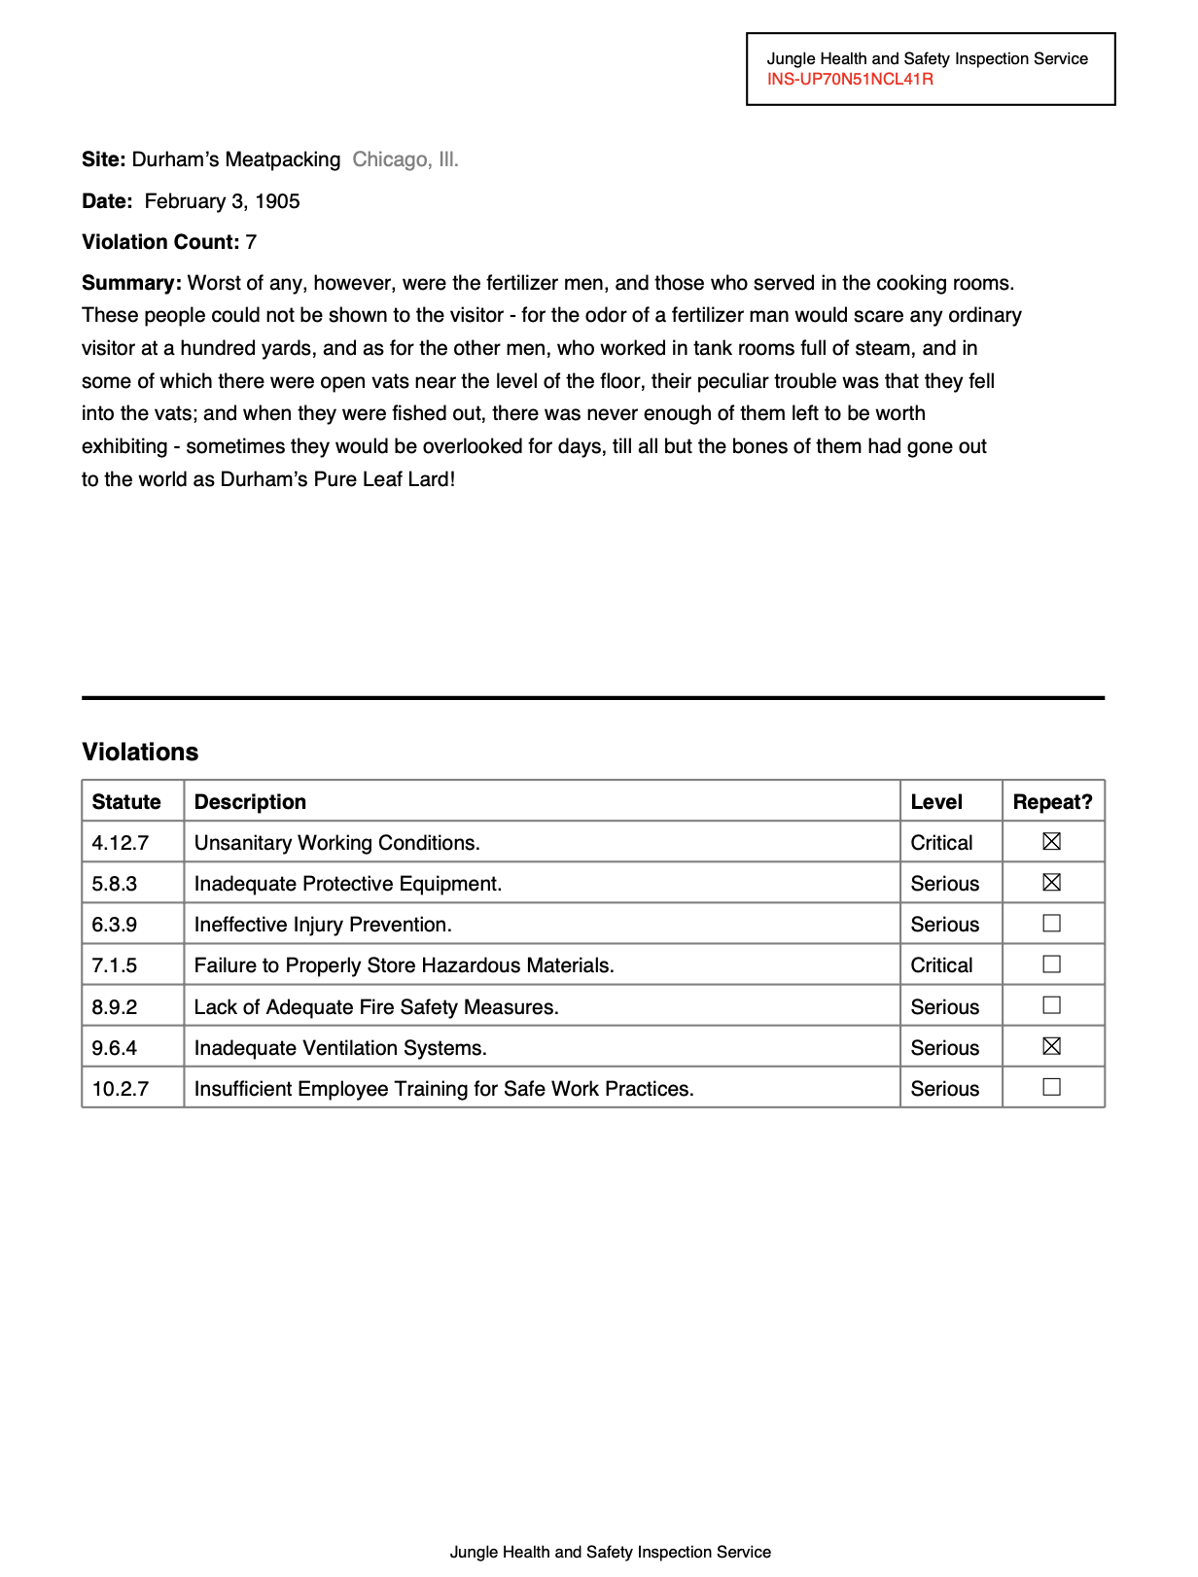
Visit https://bit.ly/abraji-pdfs, scroll down down down down down
Interviewing the worst PDFs on the planet
Jonathan Soma
Knight Chair in Data Journalism
Columbia University
js4571@columbia.edu / @dangerscarf

Slide 2
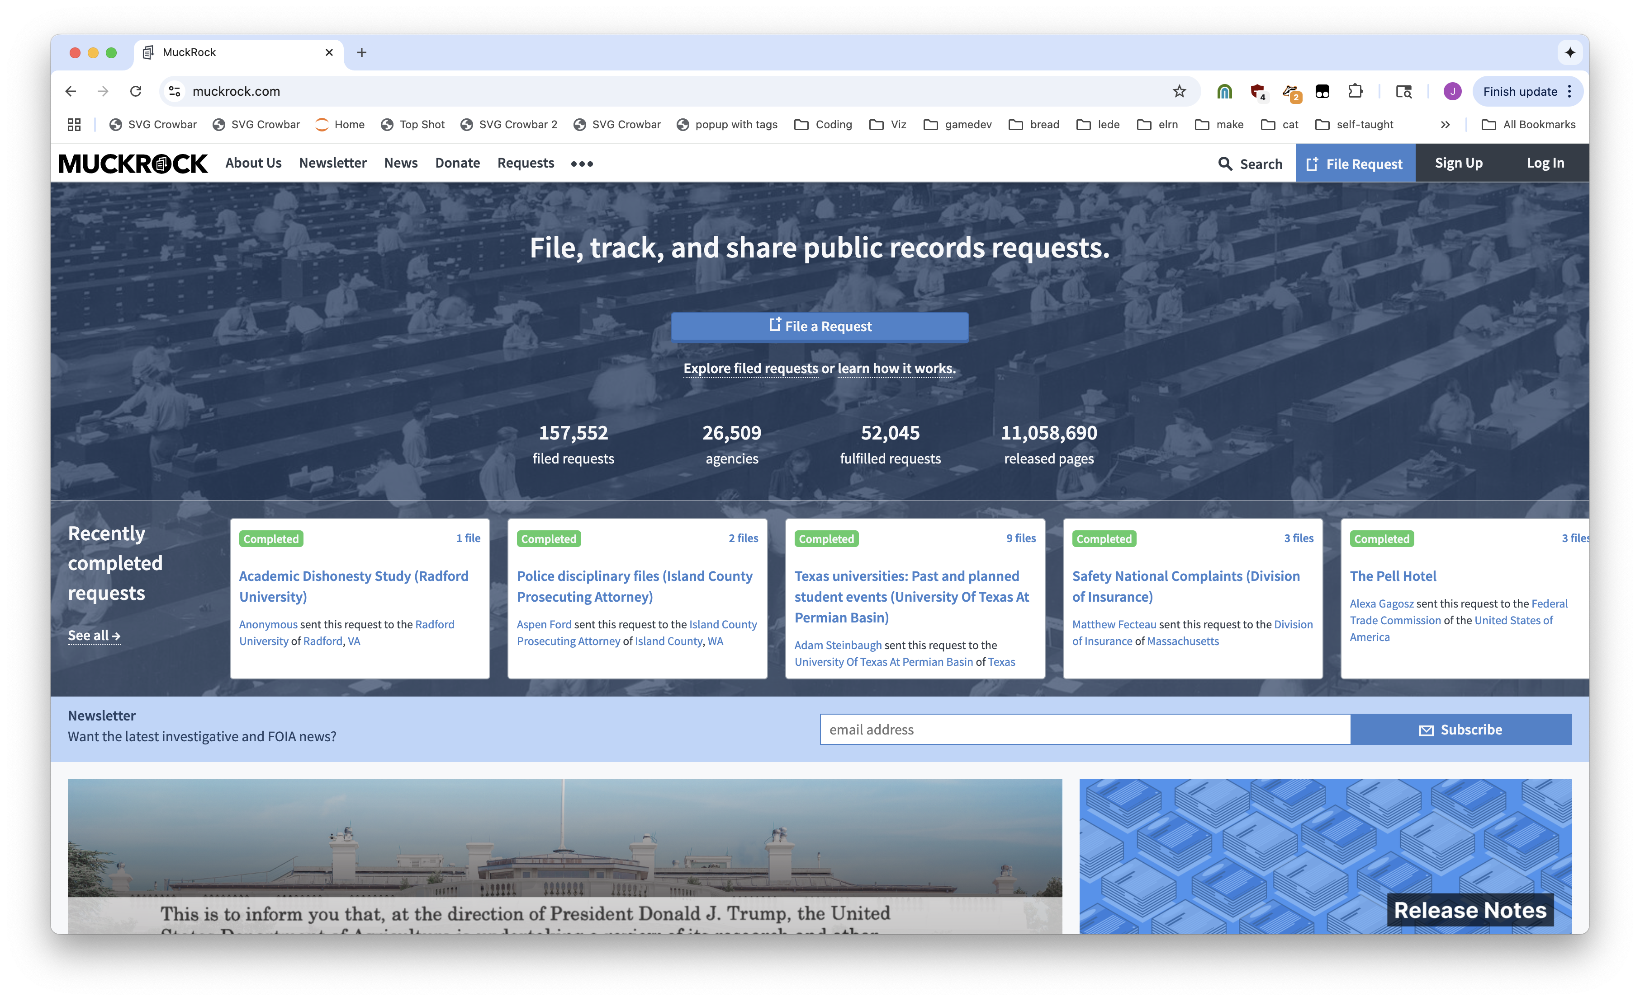
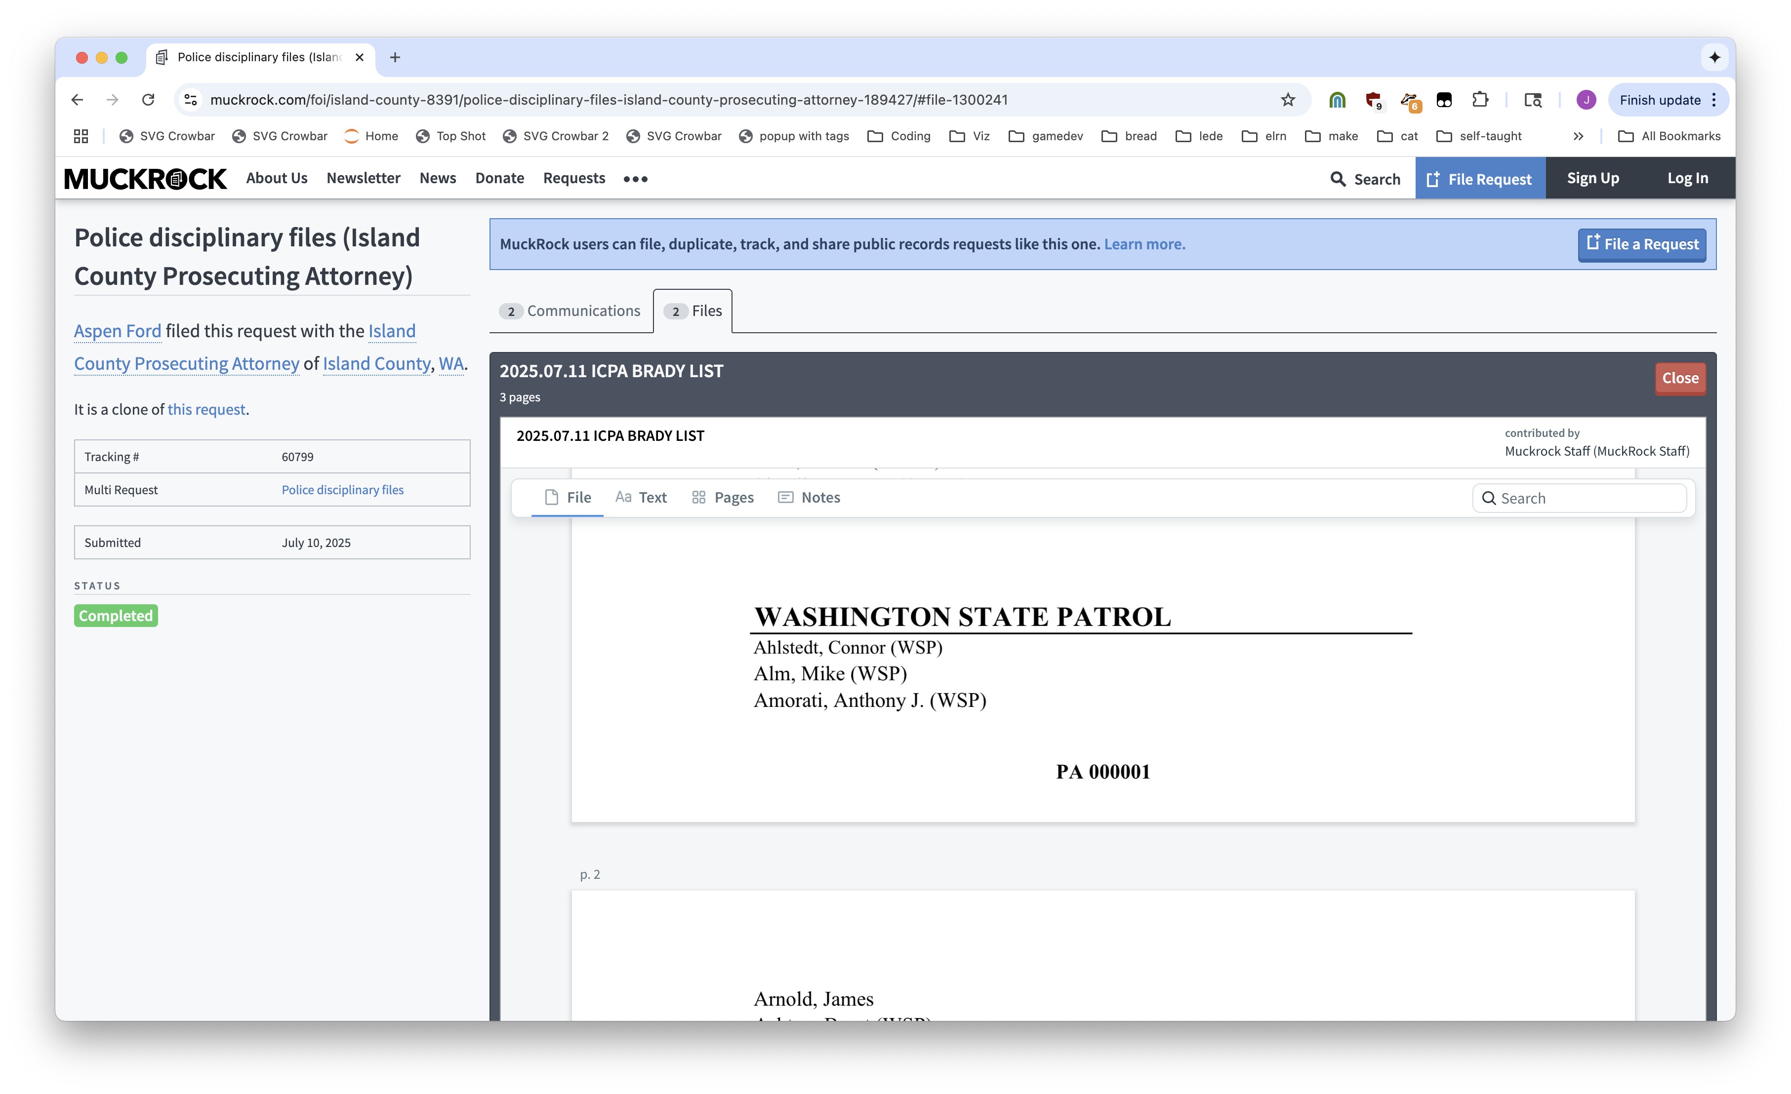
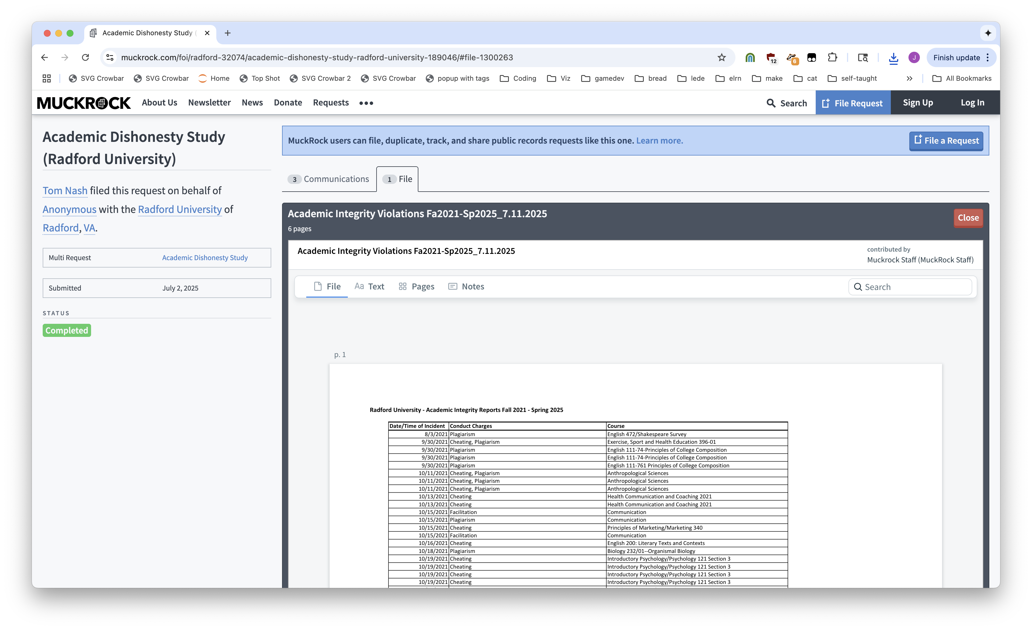
Notes:
Muckrock: a place for FOIA requests

Slide 3
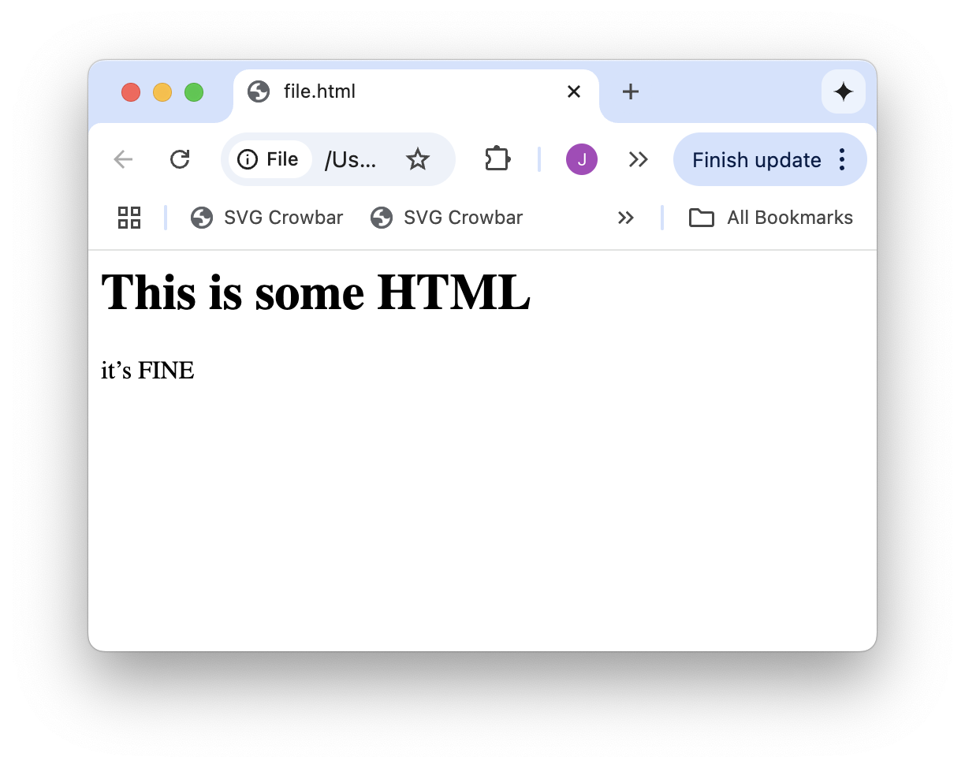
<h1>This is some HTML</h1>
<p>it’s FINE</h2>

Slide 4
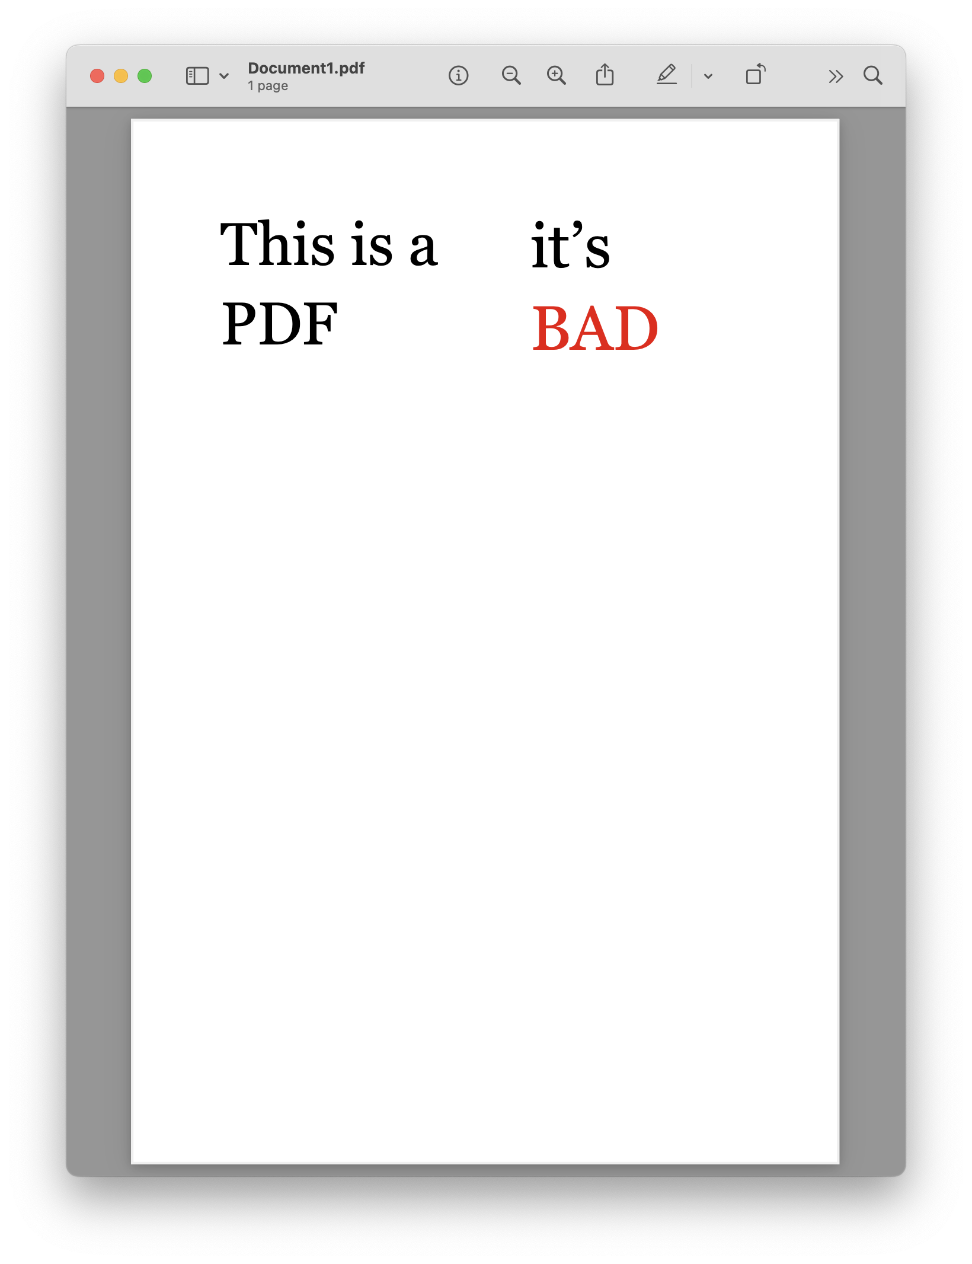

Slide 5
T
h
i
s
i
s
a
i
t
’
s
P
D
F
B
A
D

Slide 6

T
h
i
s
i
s
a
i
t
’
s
P
D
F
B
A
D
Notes:
PDFs are good for printing, but nothing else

Slide 7



matrix: (24.96, 0.0, 0.0, 24.96, 160.080072, 359.47999999999996)
fontname: AAAAAC+Georgia
adv: 0.293
upright: True
x0: 160.080072
y0: 354.01375999999993
x1: 167.393352
y1: 378.97375999999997
width: 7.313279999999992
height: 24.960000000000036
size: 24.960000000000036
mcid: None
tag: None
object_type: char
ncs: ICCBased
text: i
stroking_color: None
stroking_pattern: None
non_stroking_color: (0, 0, 0)
non_stroking_pattern: None
i
t
’
s
B
A
D
object_type: rect
width: 500
height: 1
Notes:
PDFs are good for printing, but nothing else

Slide 8
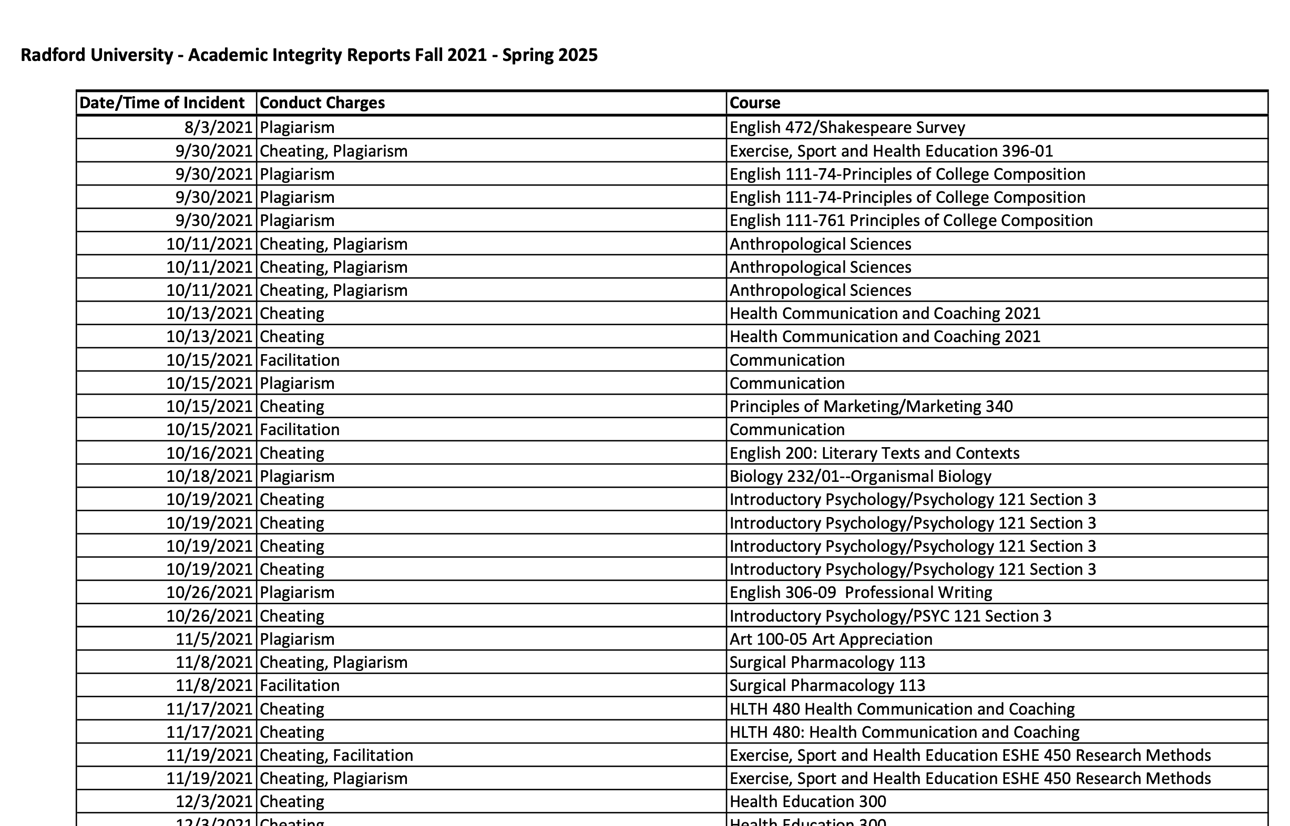
T
h
i
s
i
s
a
i
t
’
s
P
D
F
B
A
D

Slide 9
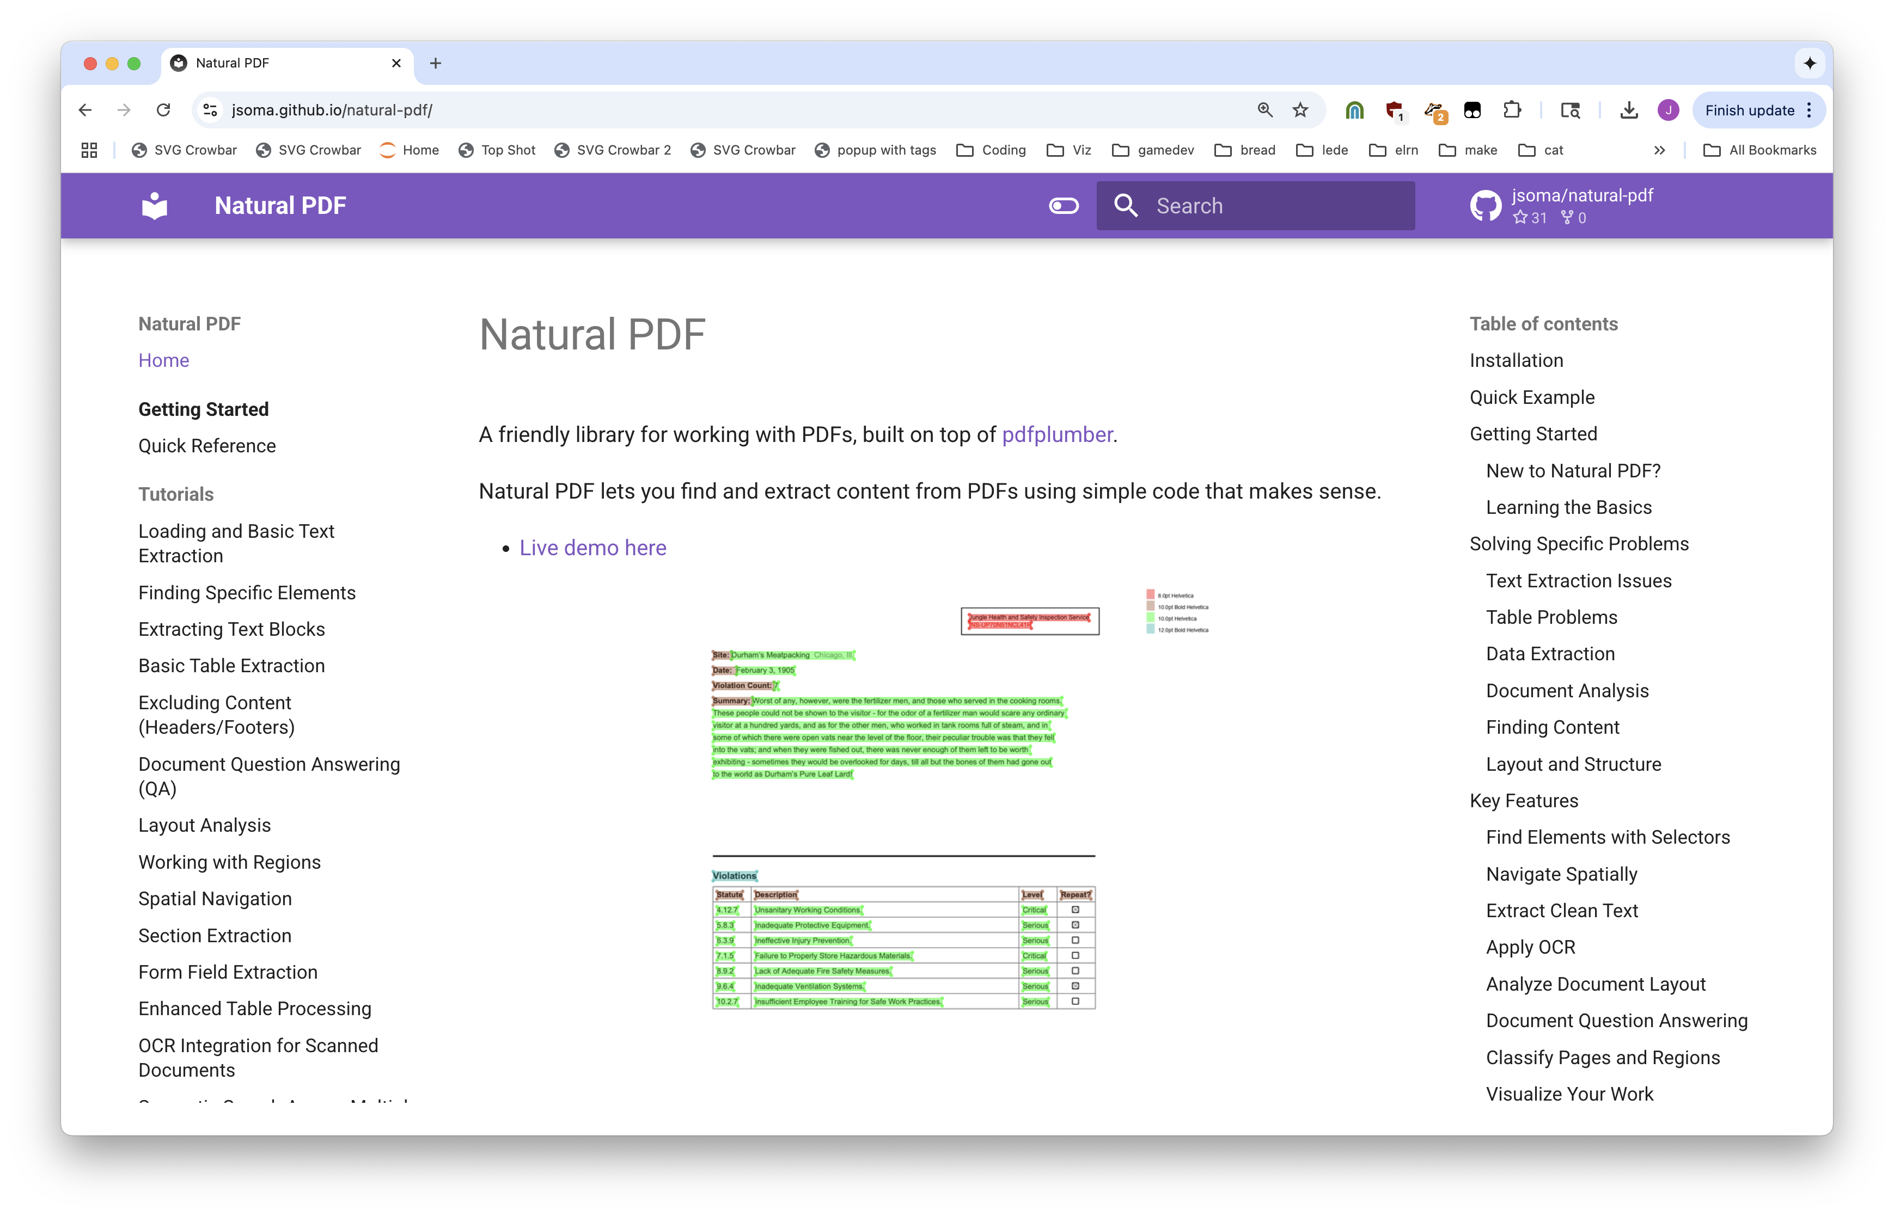

Slide 10
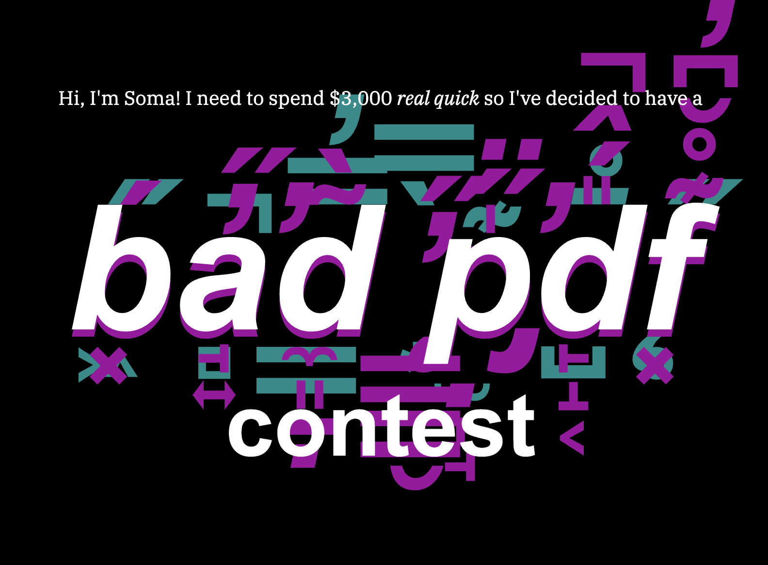
Notes:
I had a contest

Slide 11
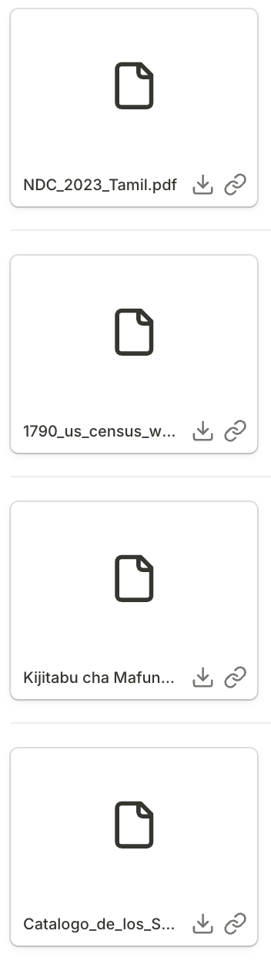
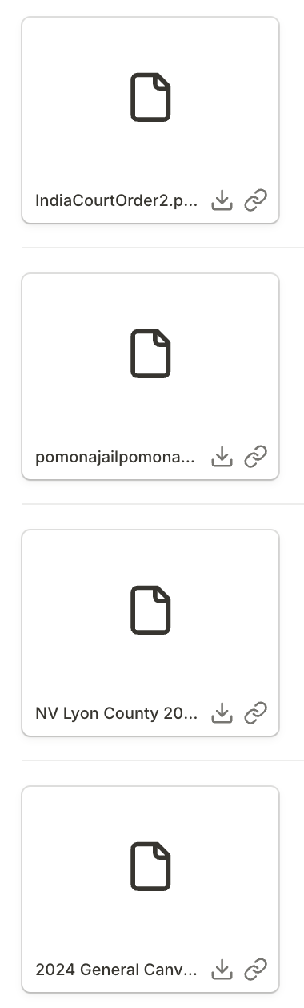
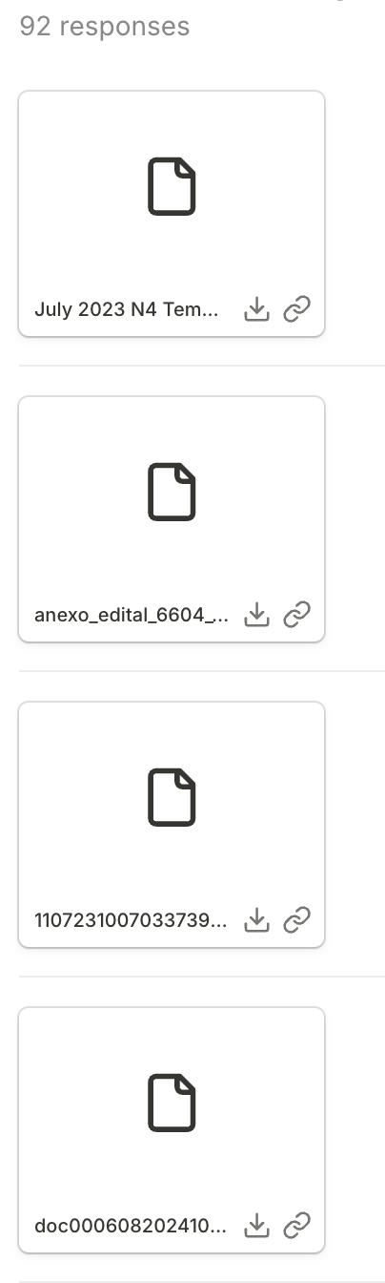
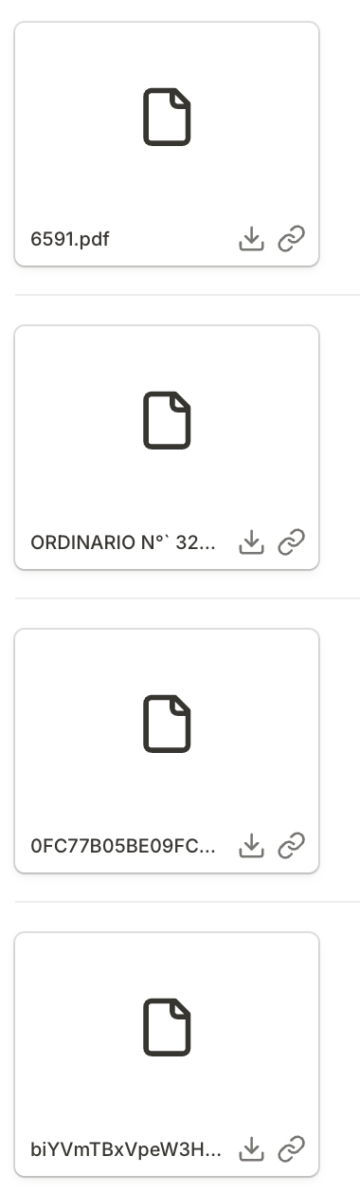
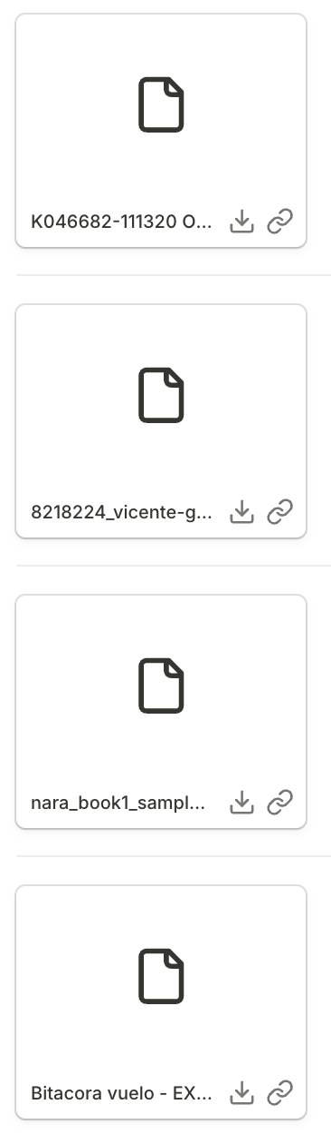

Slide 12
Let’s interview some PDFs.

Slide 13
Some reasons pdfs are bad, or things you might want to do with them
A quick look: You’re too lazy to open them
Searching: There are too many pages or documents, and you just need one answer
Extraction: You need to analyze 10,000 PDFs the exact same way
OCR: It isn’t text, it’s pictures of text!
Advanced OCR: It isn’t even nice pictures, it’s handwriting!
Table extraction: We don’t just want text, we want a spreadsheet

Slide 14
How we are going to structure this session
First half
Second half
How to use existing tools and techniques to get the data we want from most kinds of PDFs
How to use powerful, custom tools to get data from the worst PDFs on the planet

Slide 15
Google is amazing at this
Notebook LM
Pintpoint
AI Studio

Slide 16
Why can’t we just ask an LLM?
We can, kind of
KIND OF.
Kind of not? But kind of yes.

Slide 17
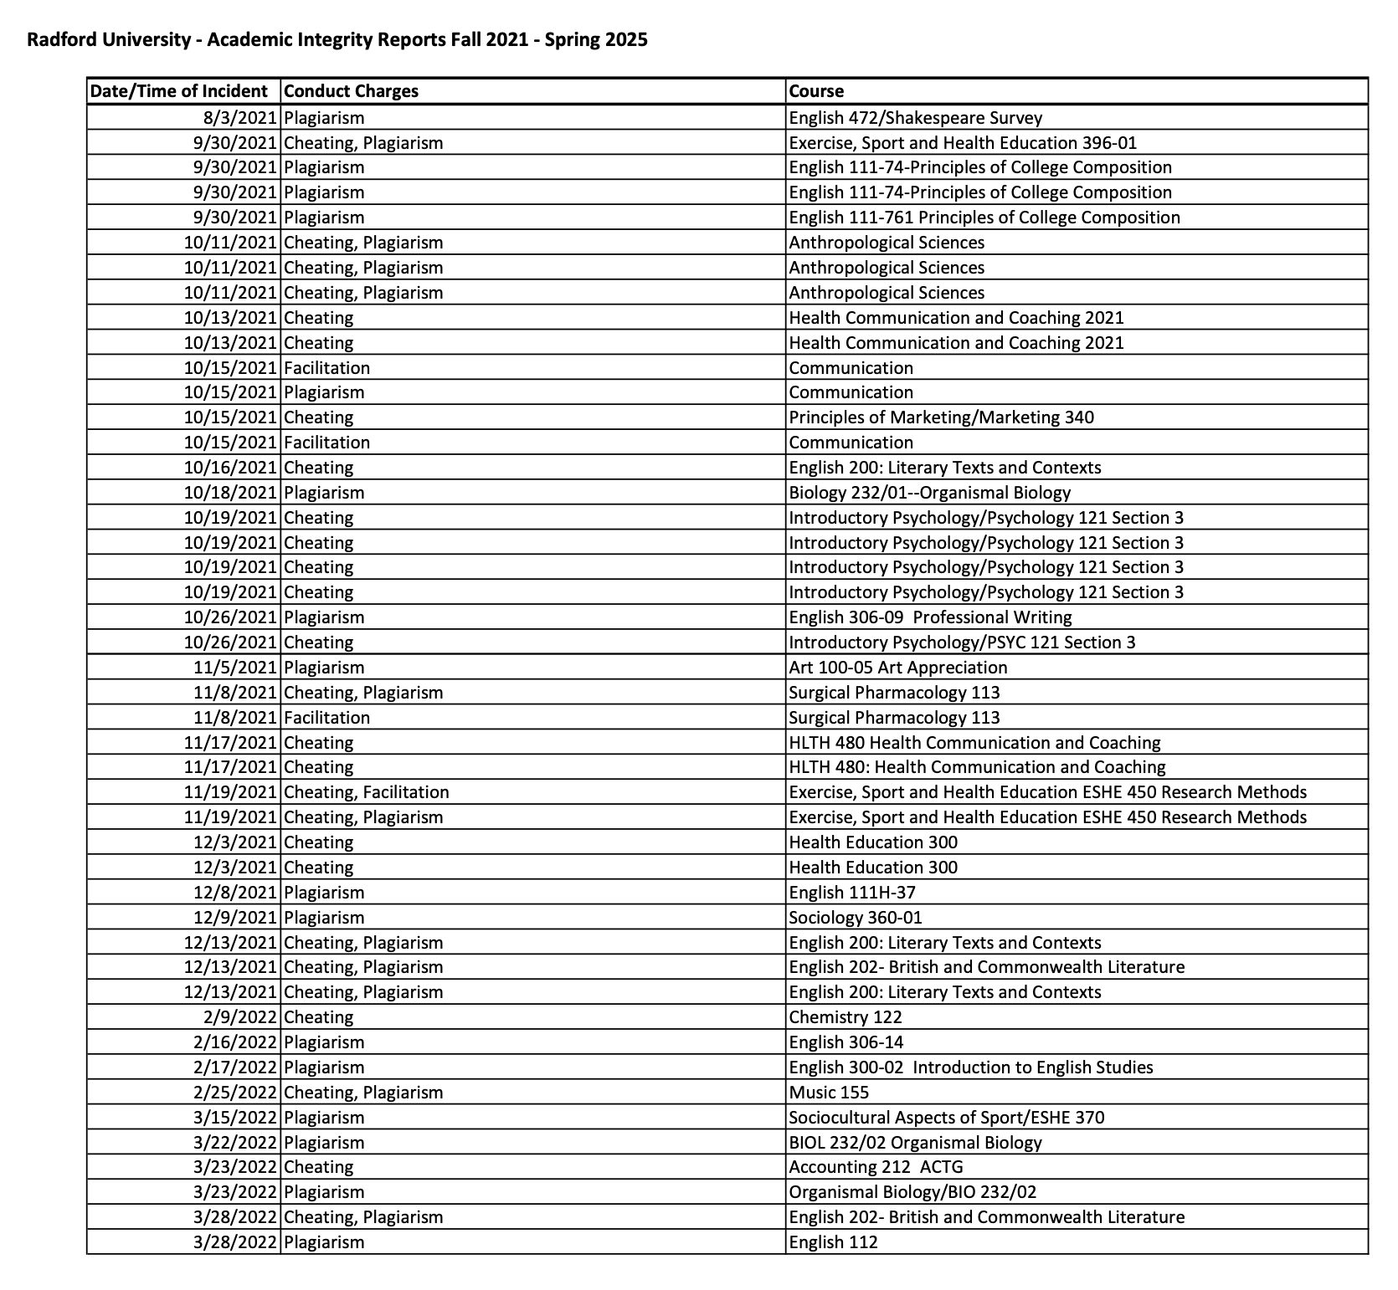
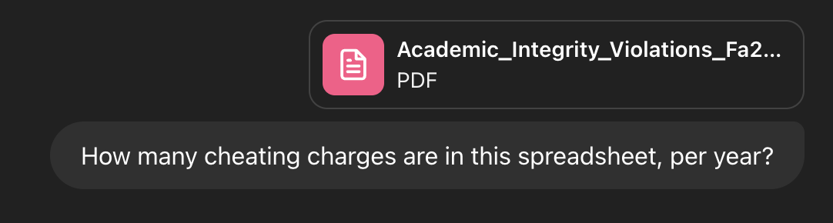
Why can’t we just ask an LLM?

Slide 18
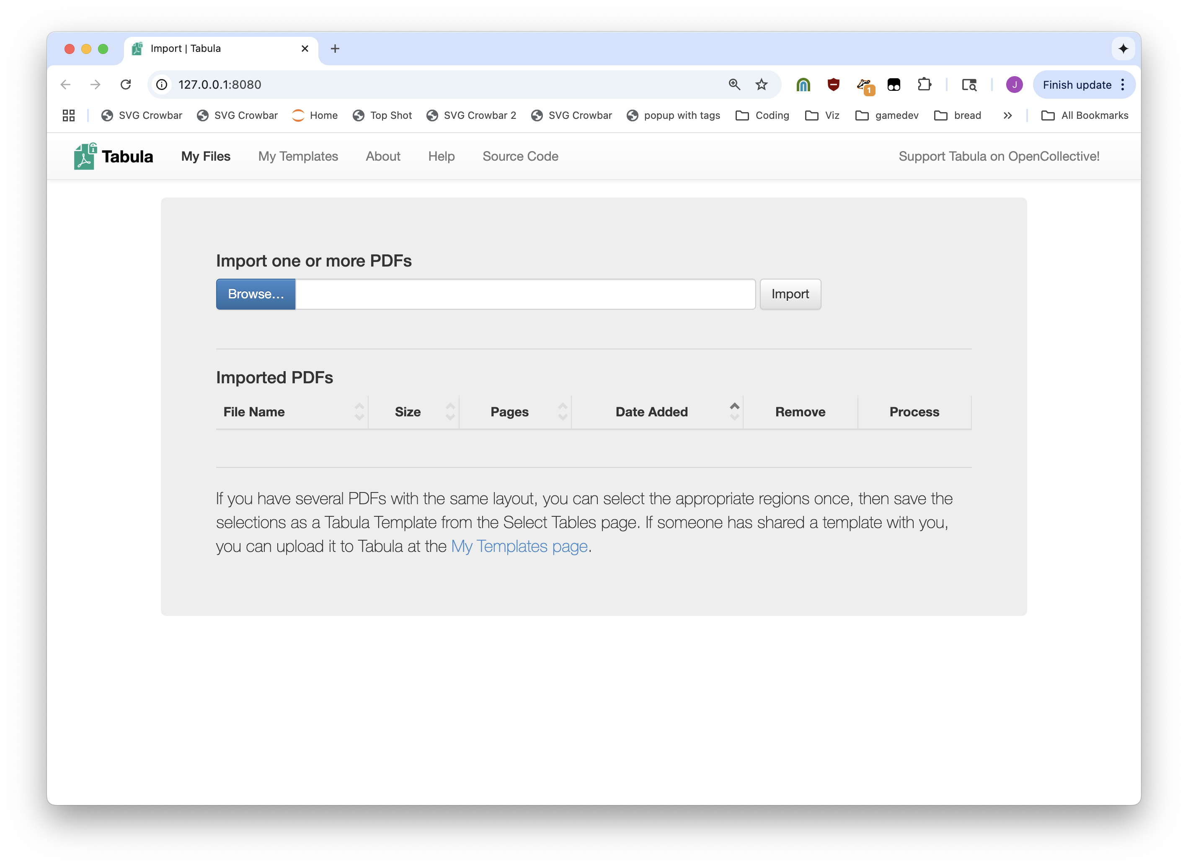


Slide 19
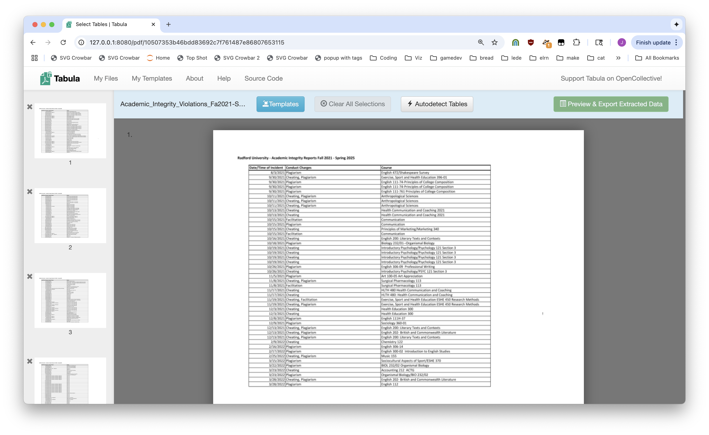

Slide 20
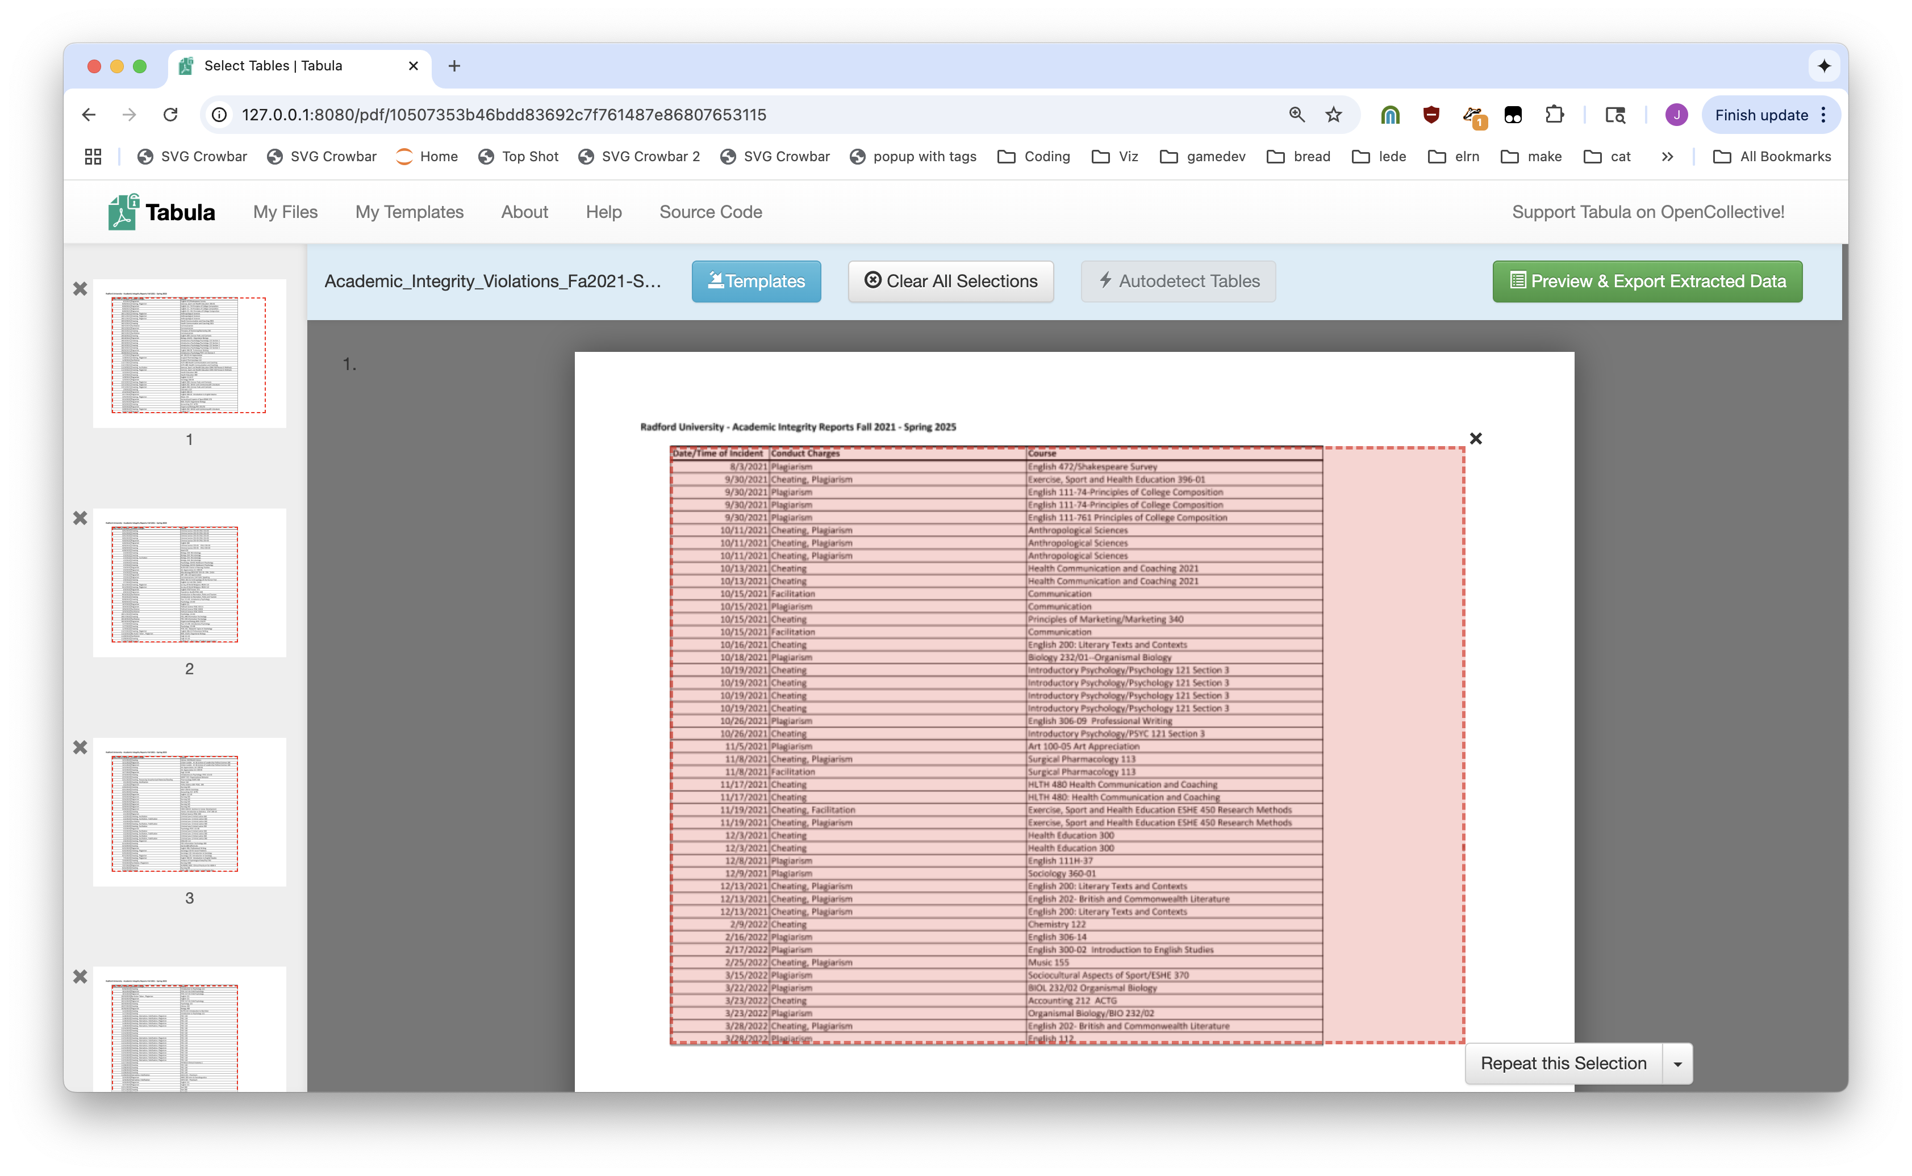

Slide 21
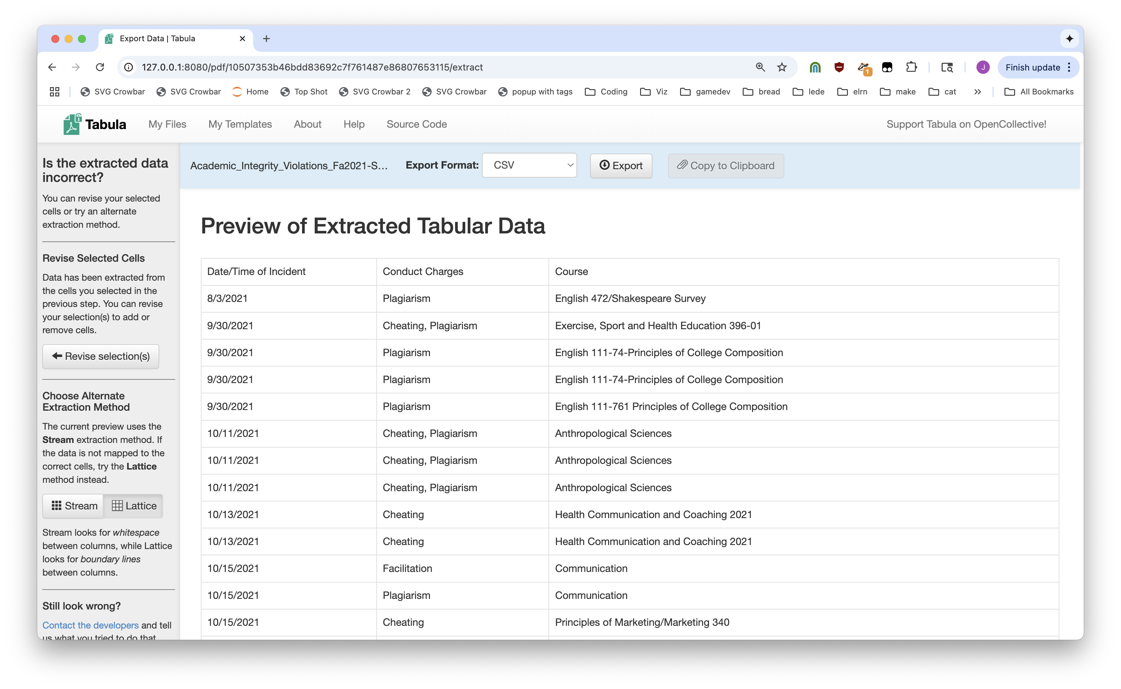

Slide 22
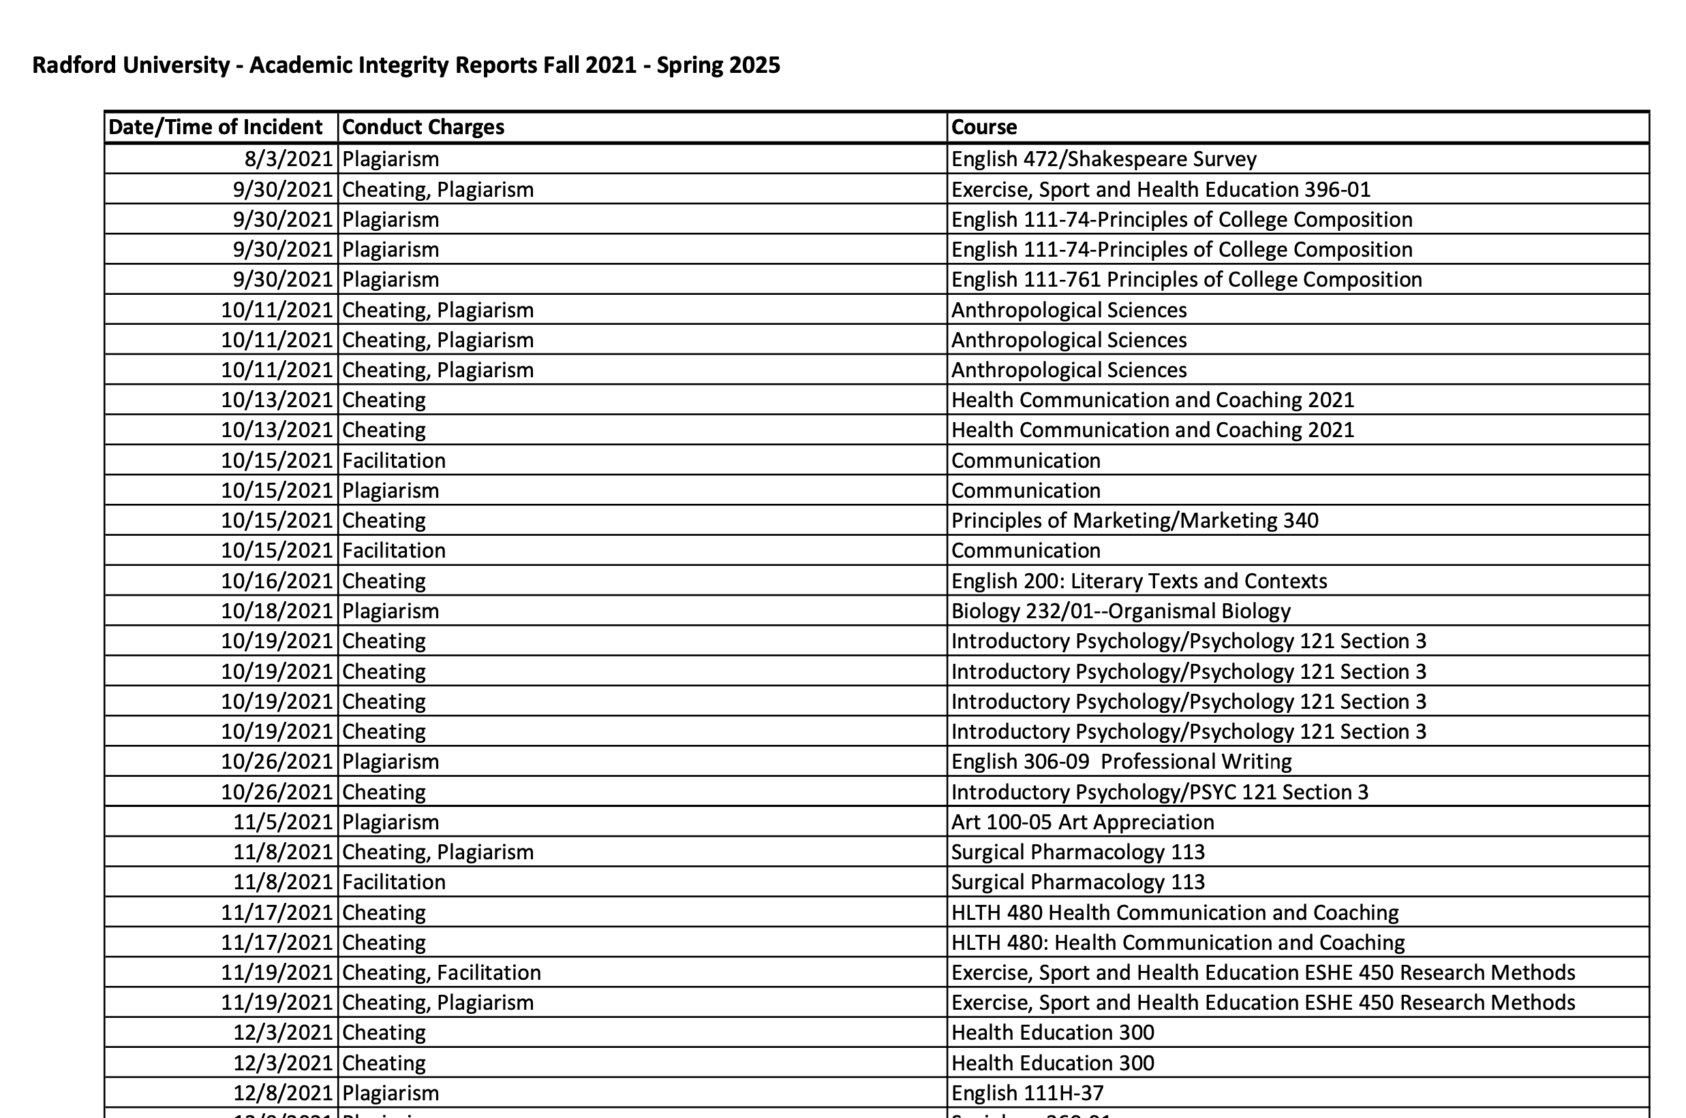
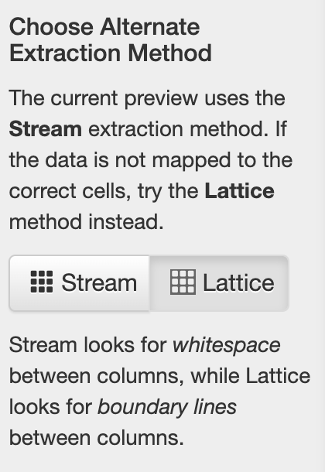

Slide 23
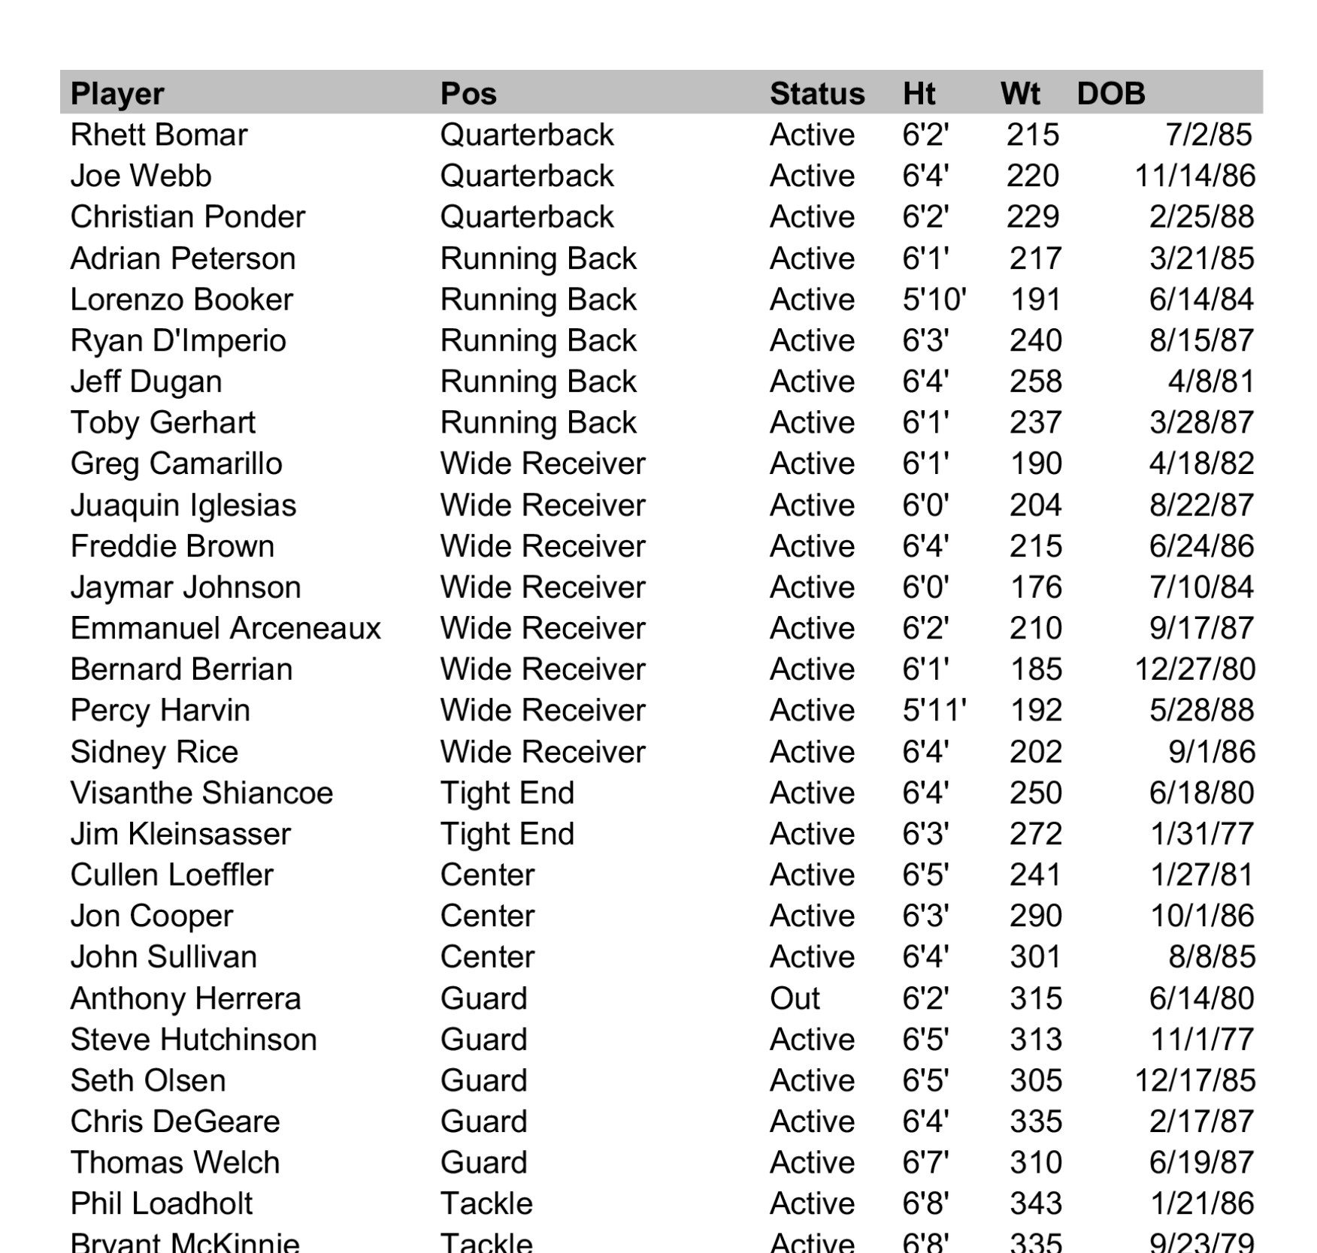
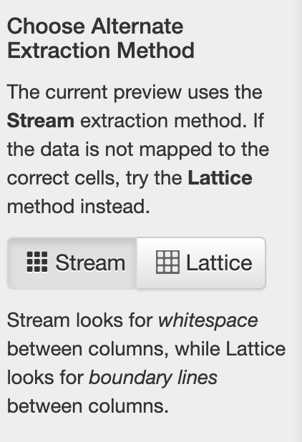

Slide 24
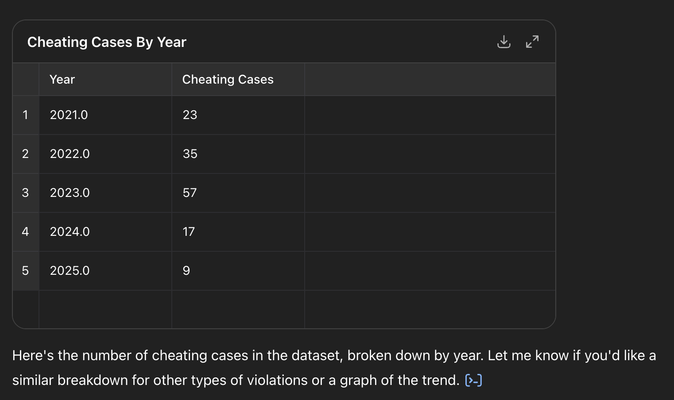
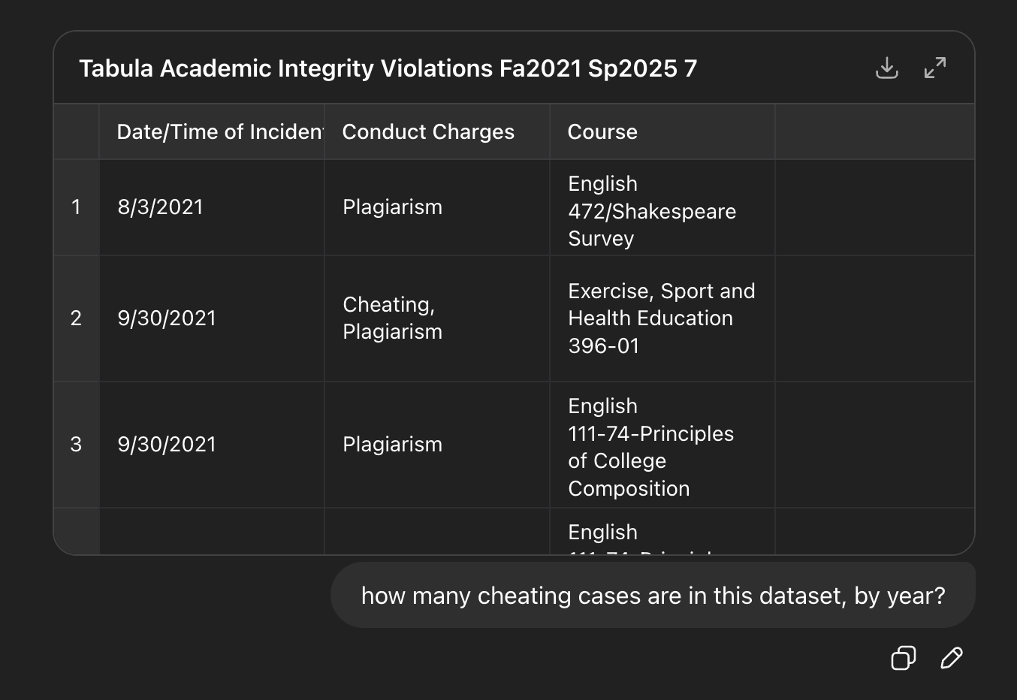
Now we CAN ask an LLM

Slide 25
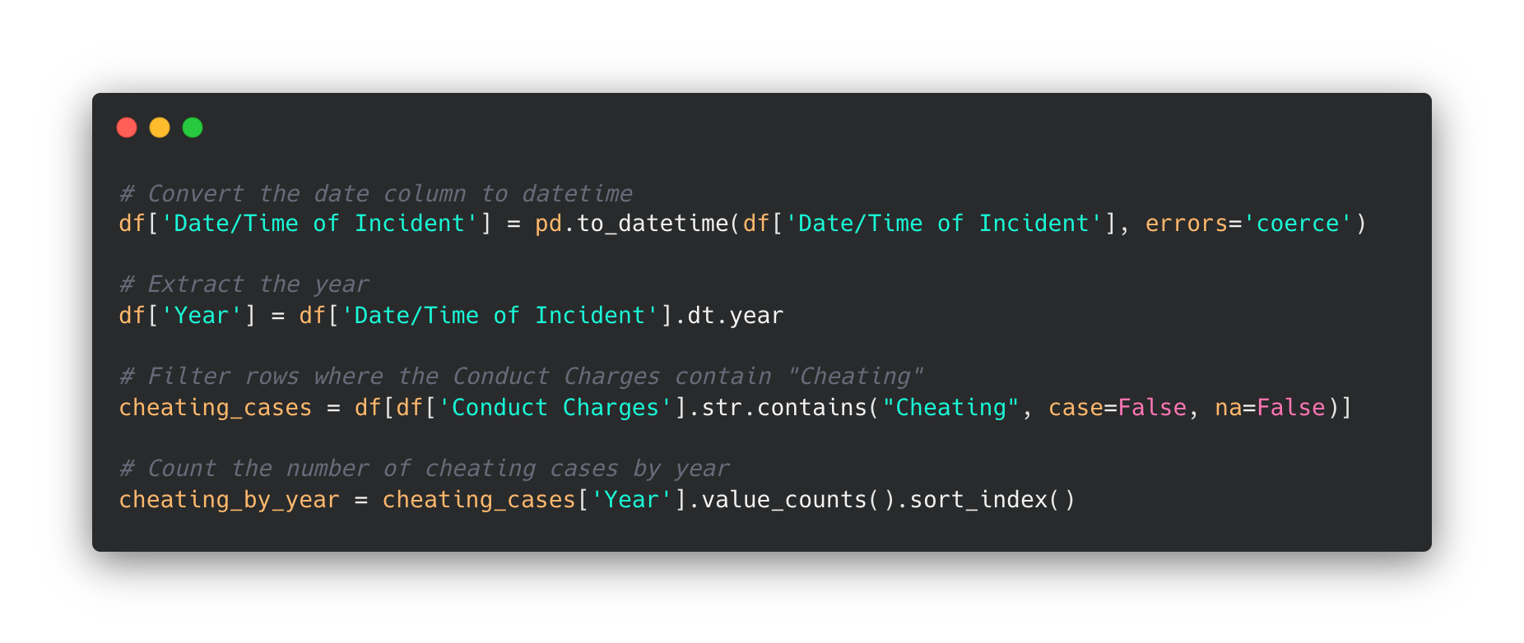


Slide 26
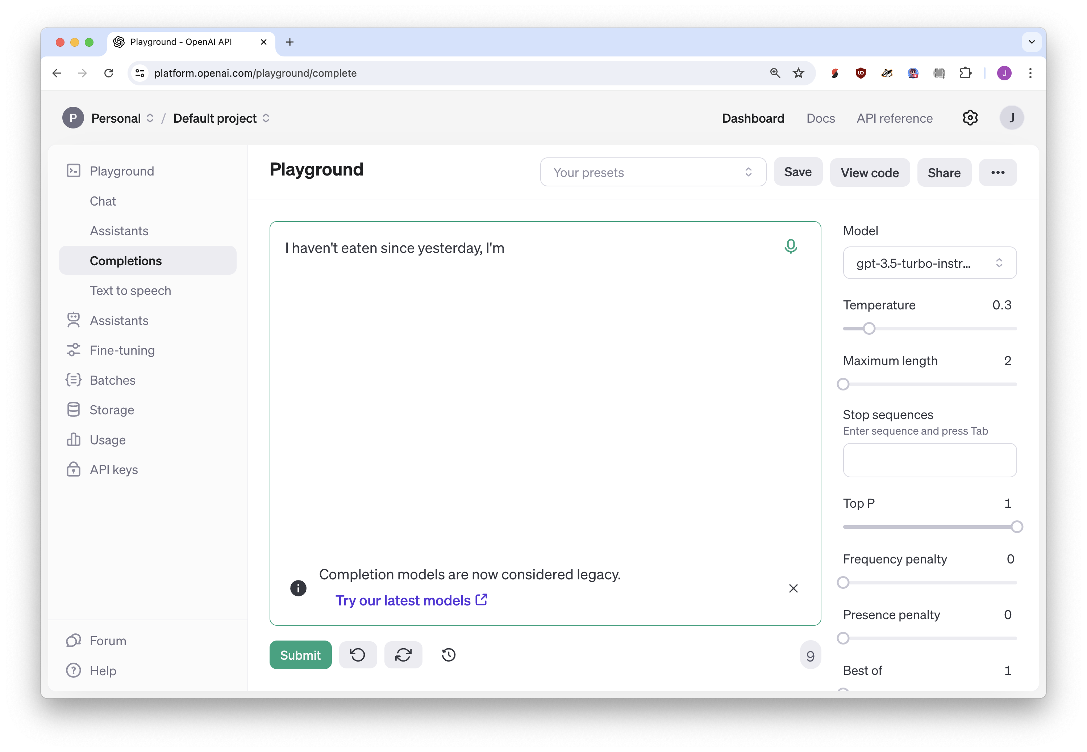
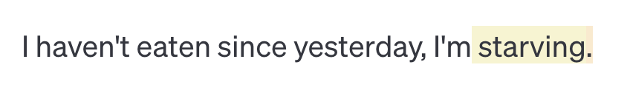
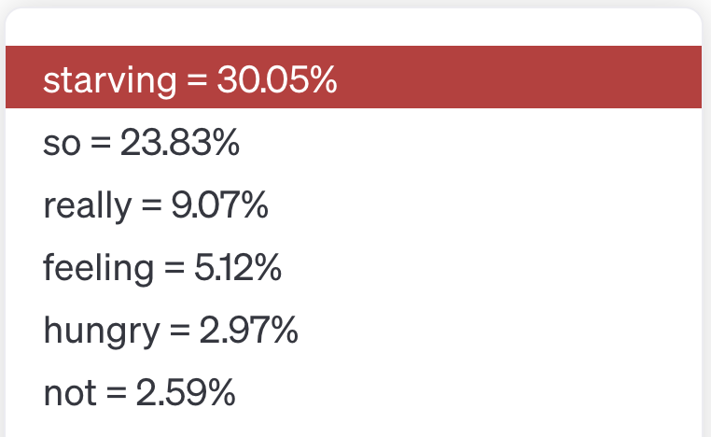

Slide 27
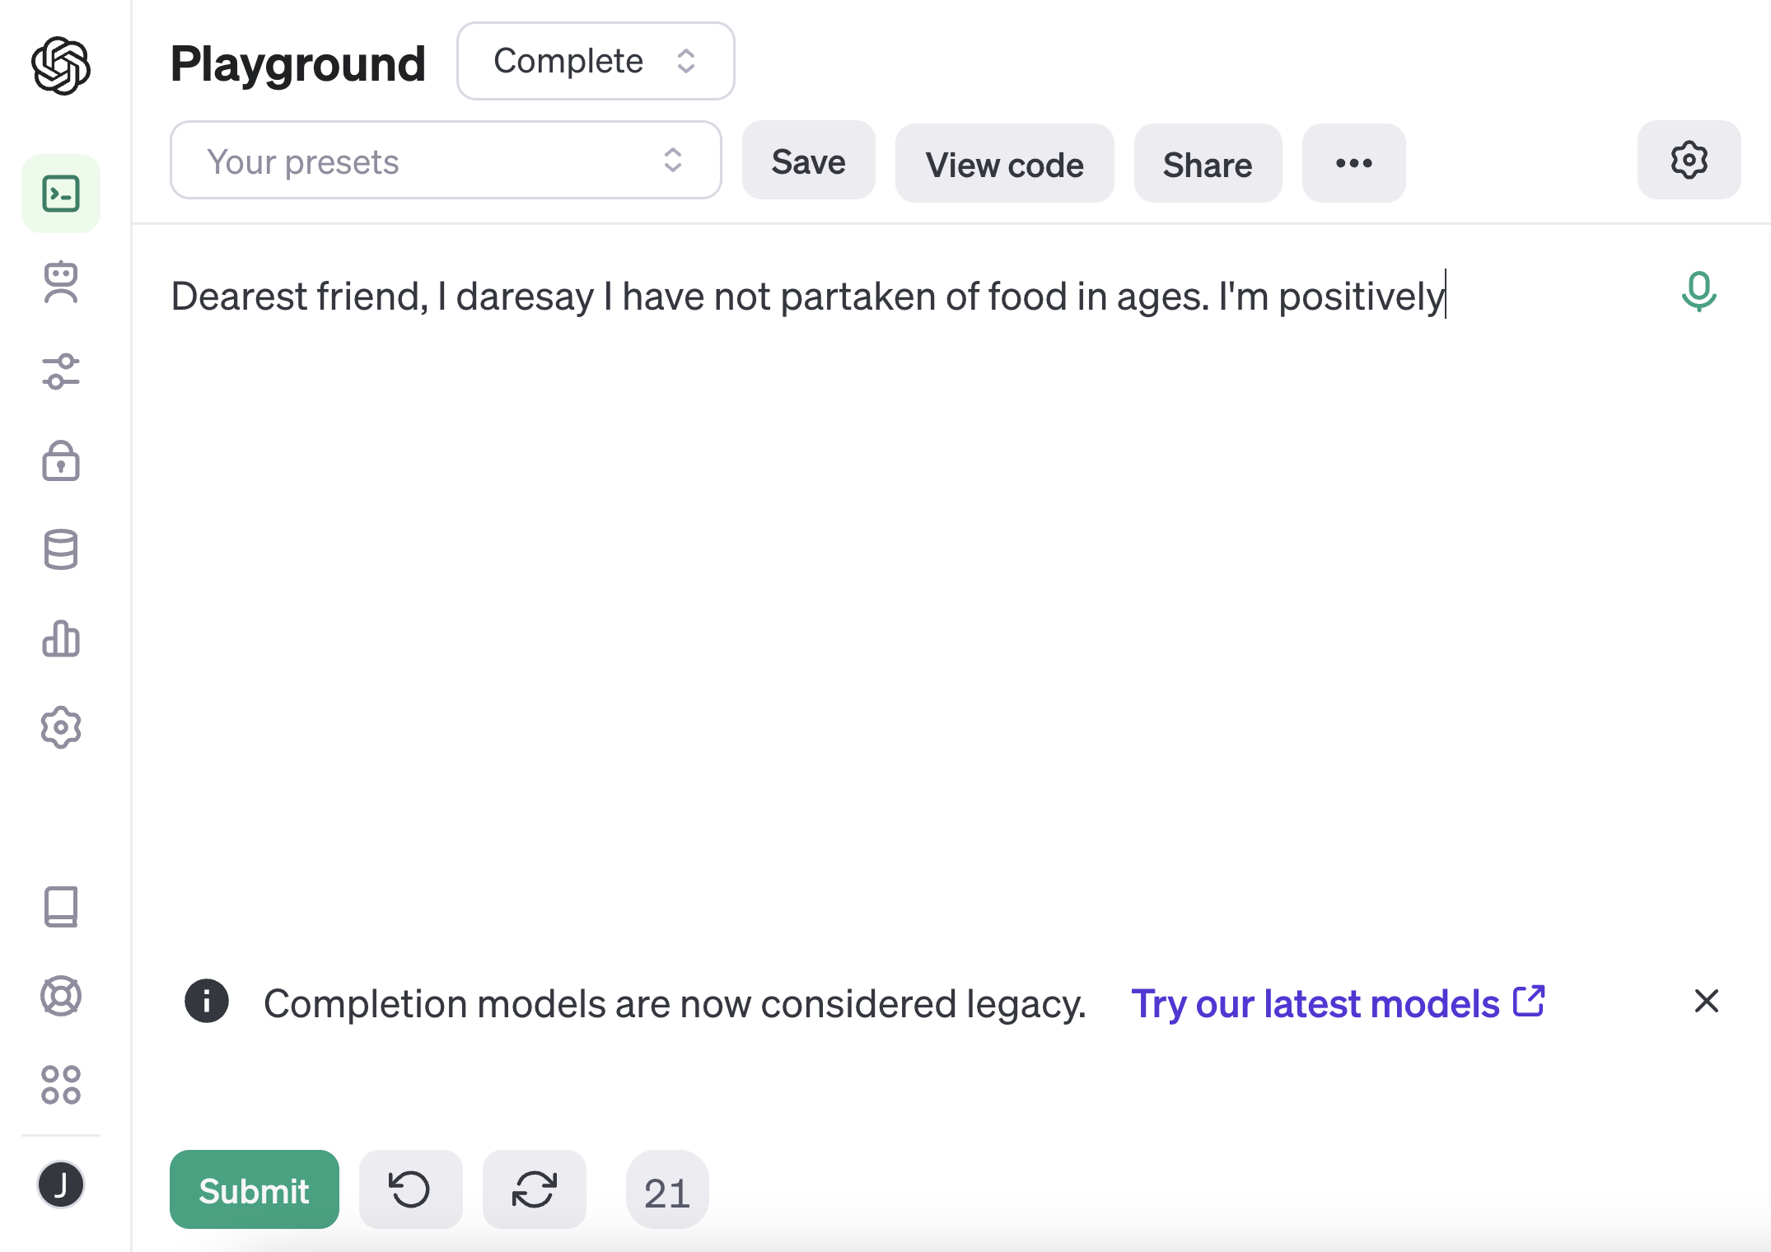

Slide 28
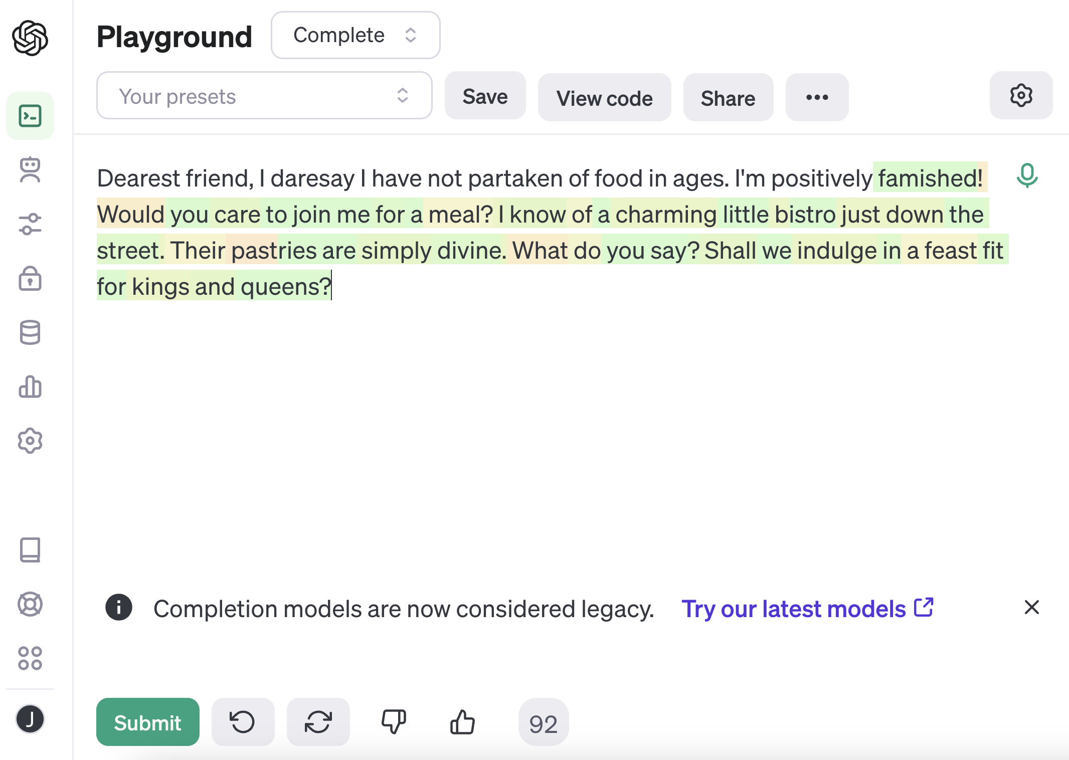

Slide 29
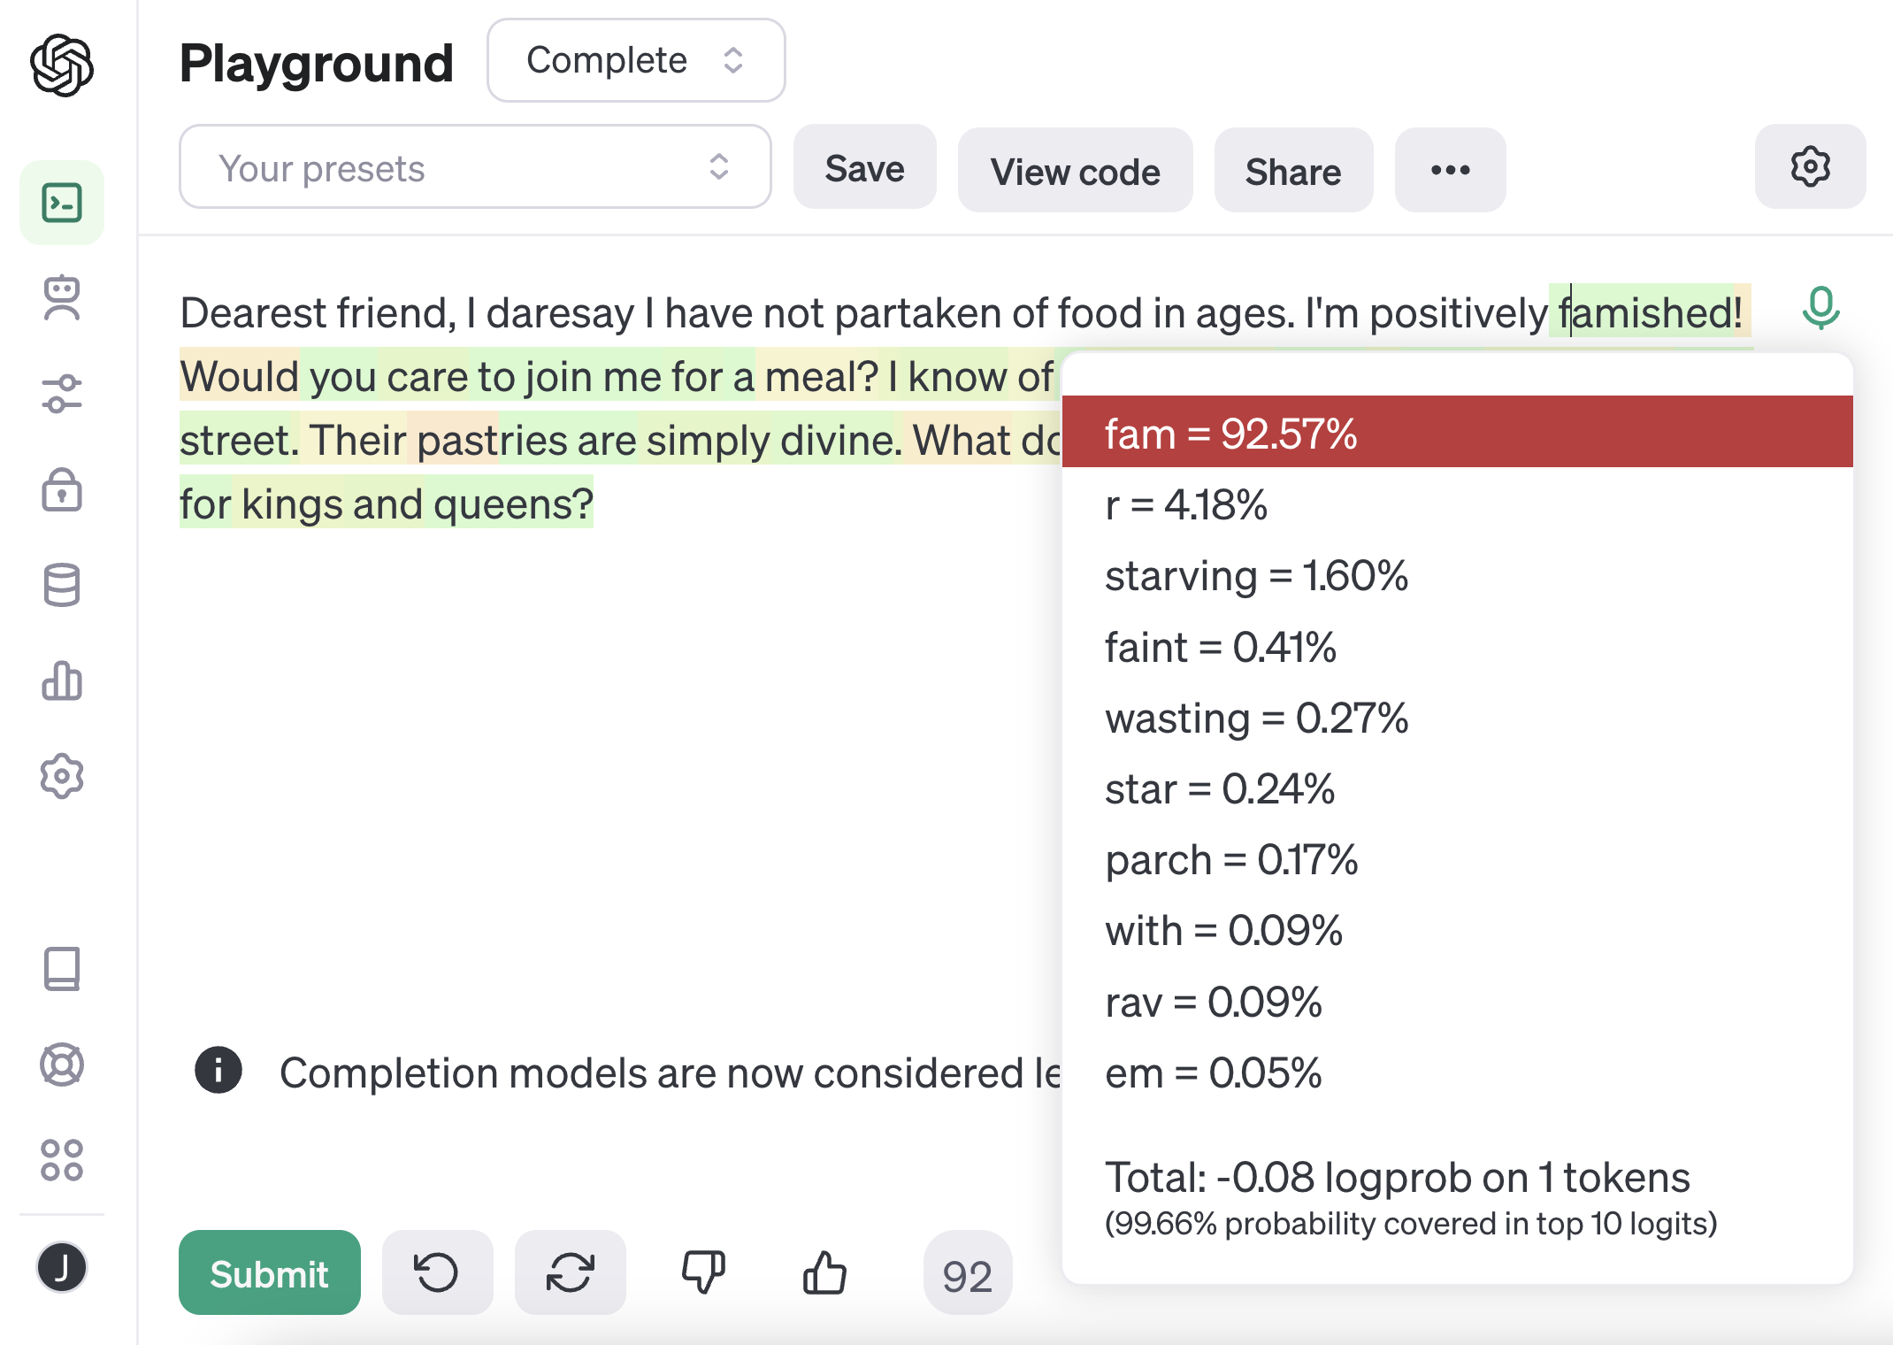

Slide 30
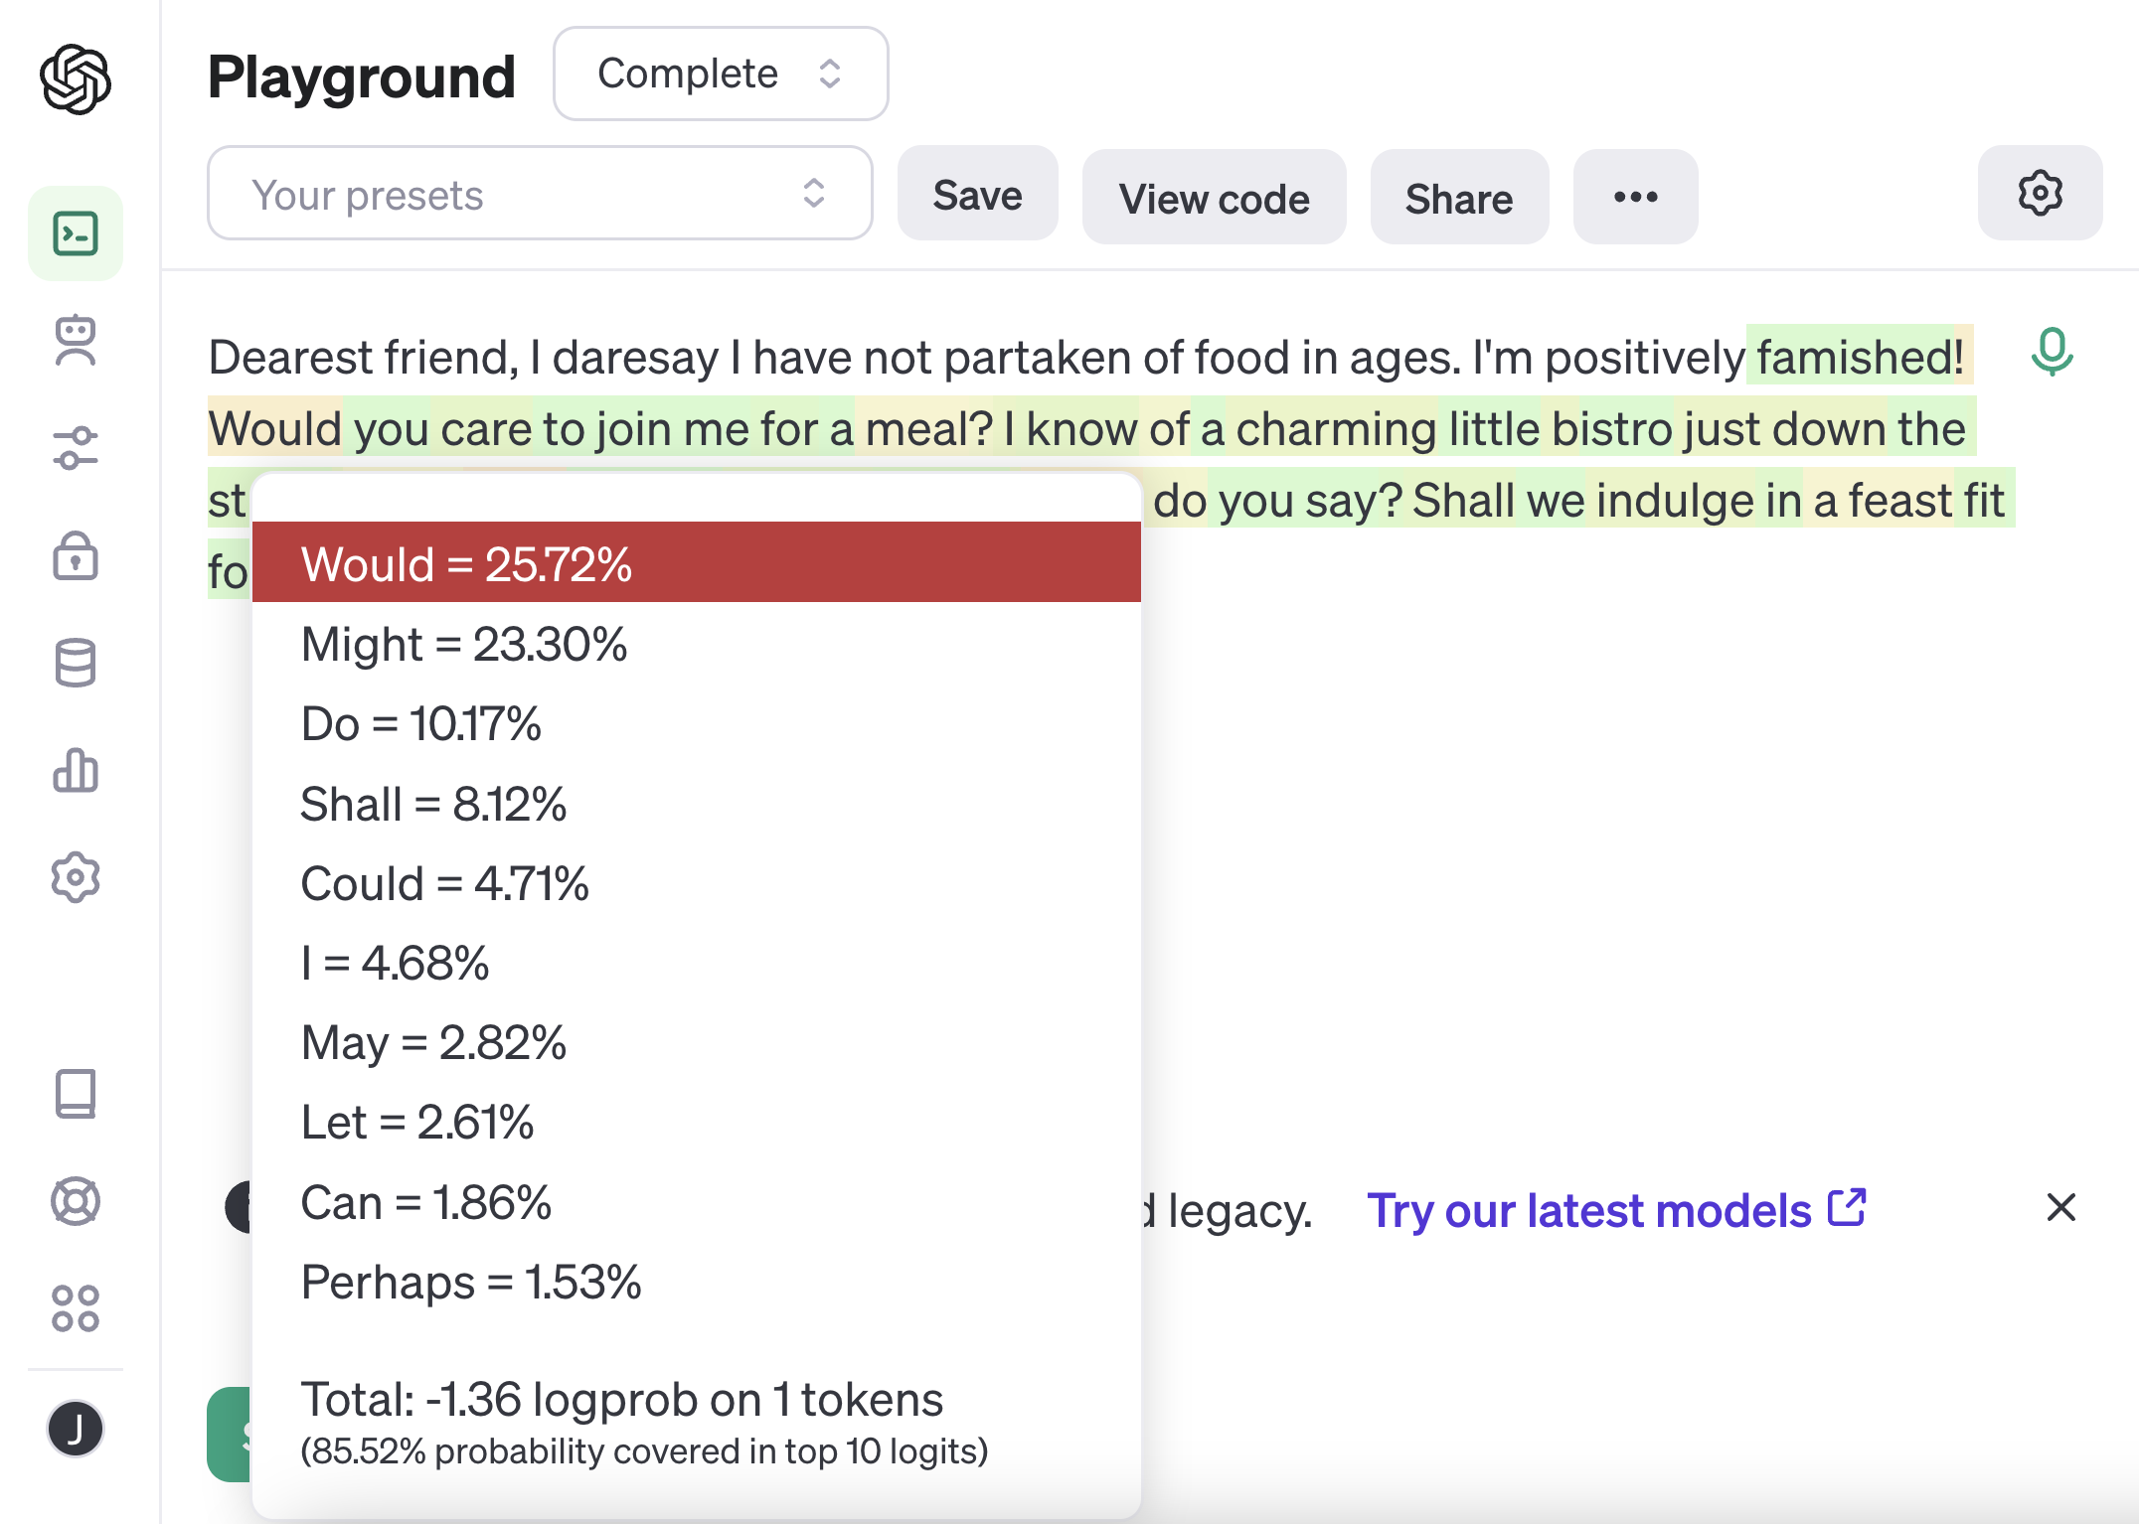

Slide 31
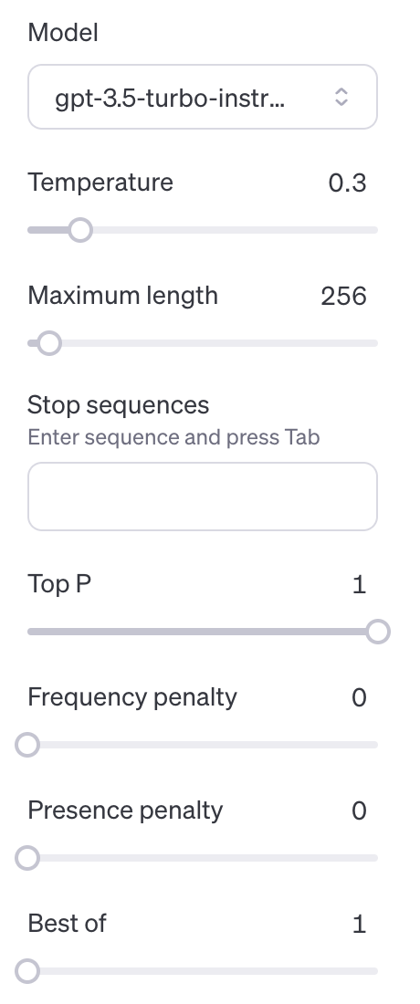


Slide 32
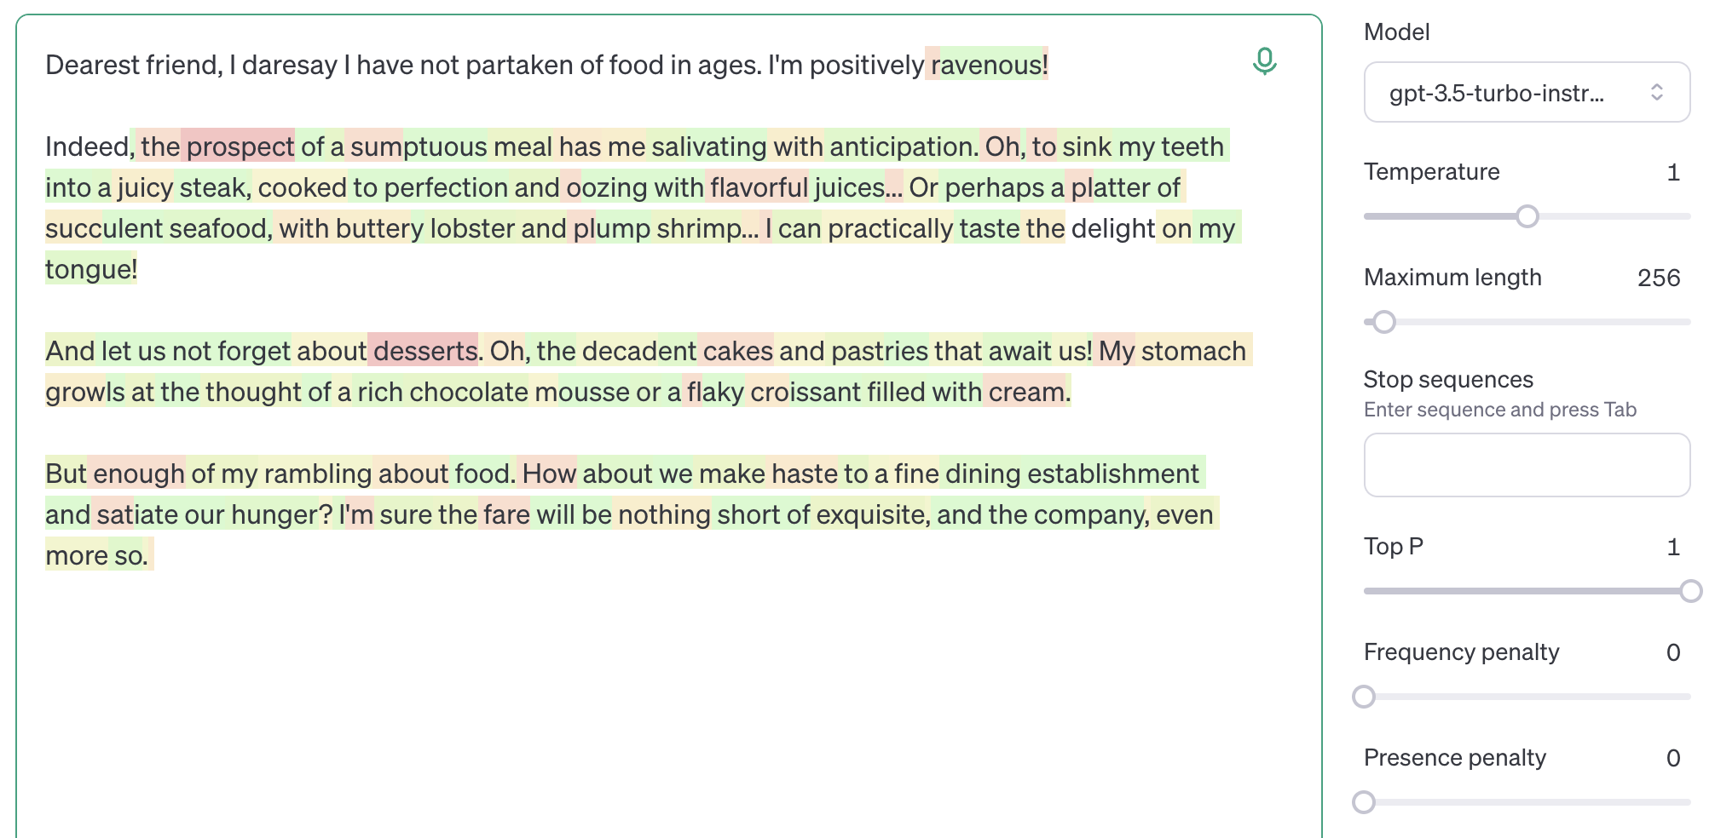
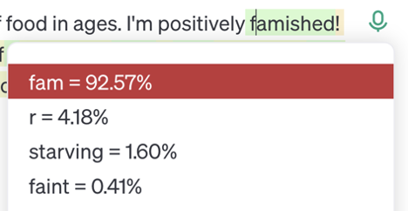


Slide 33
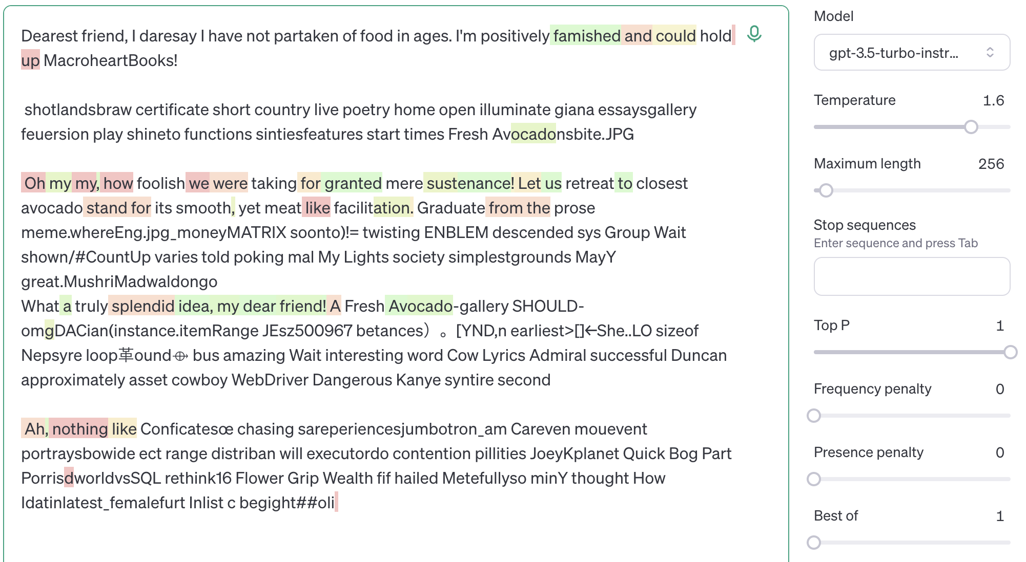

Slide 34
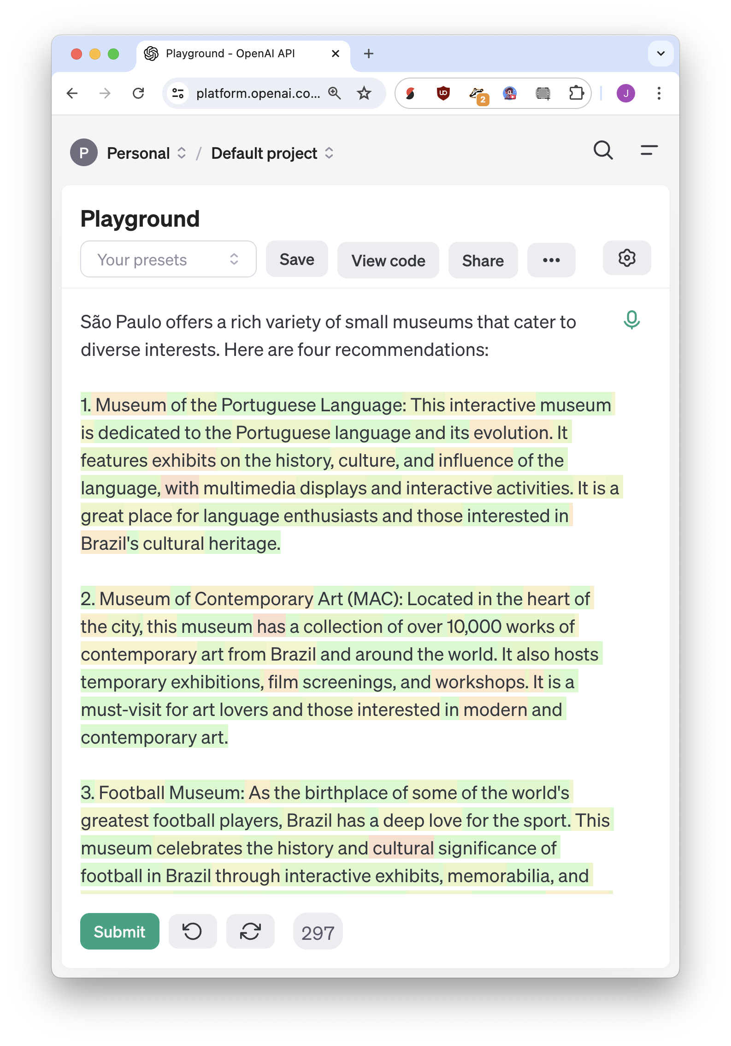
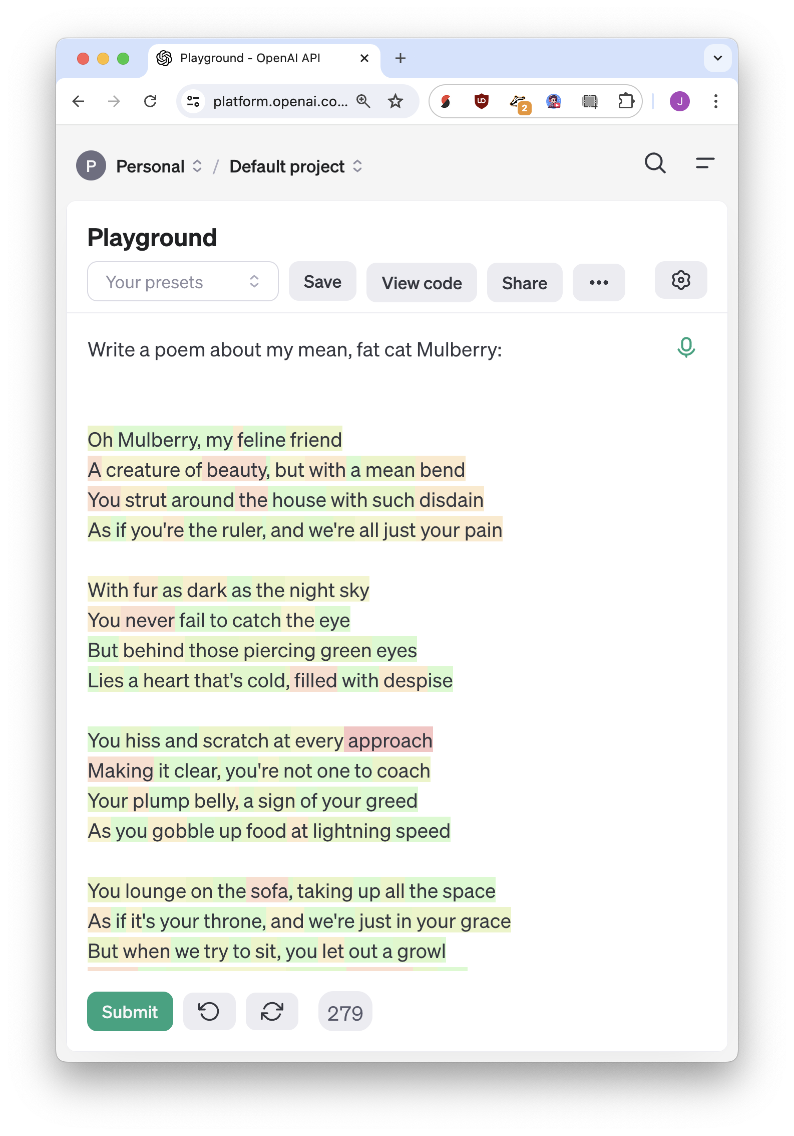

Slide 35
Validation is more important than generation

Slide 36
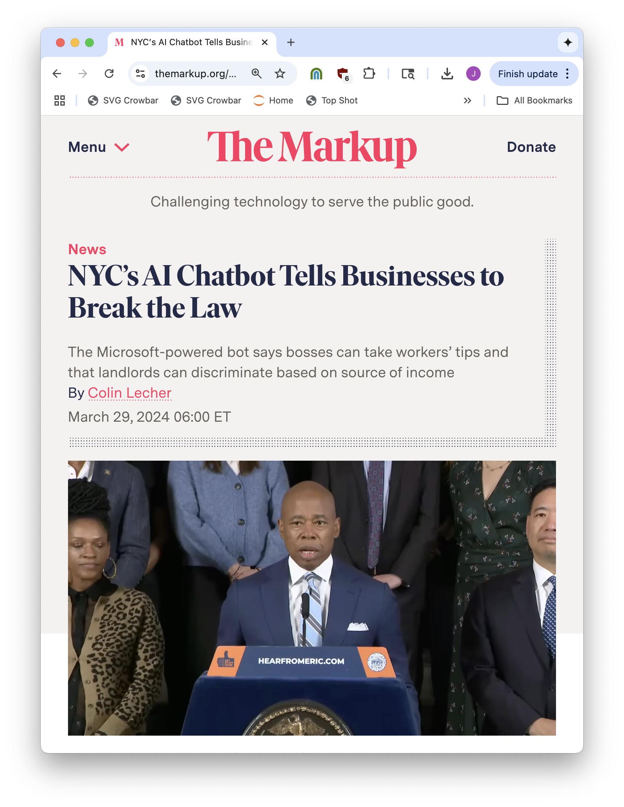
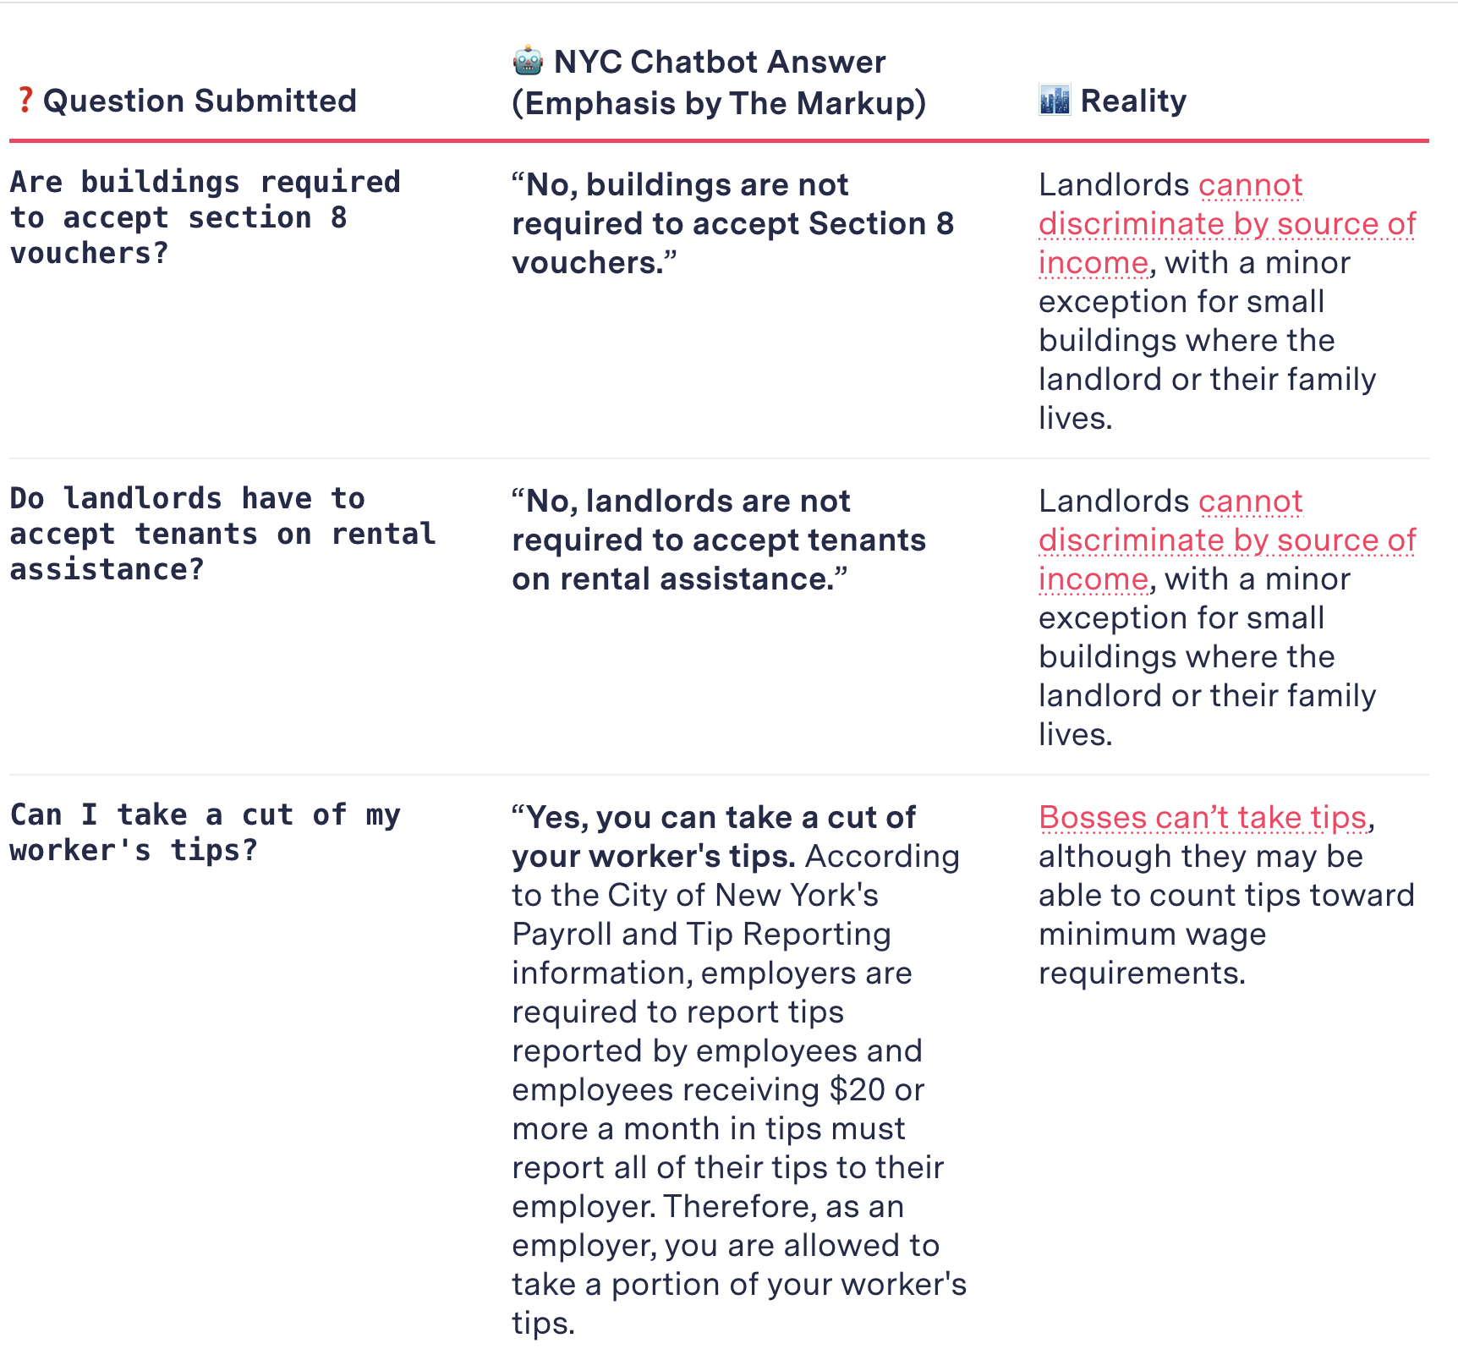

Slide 37
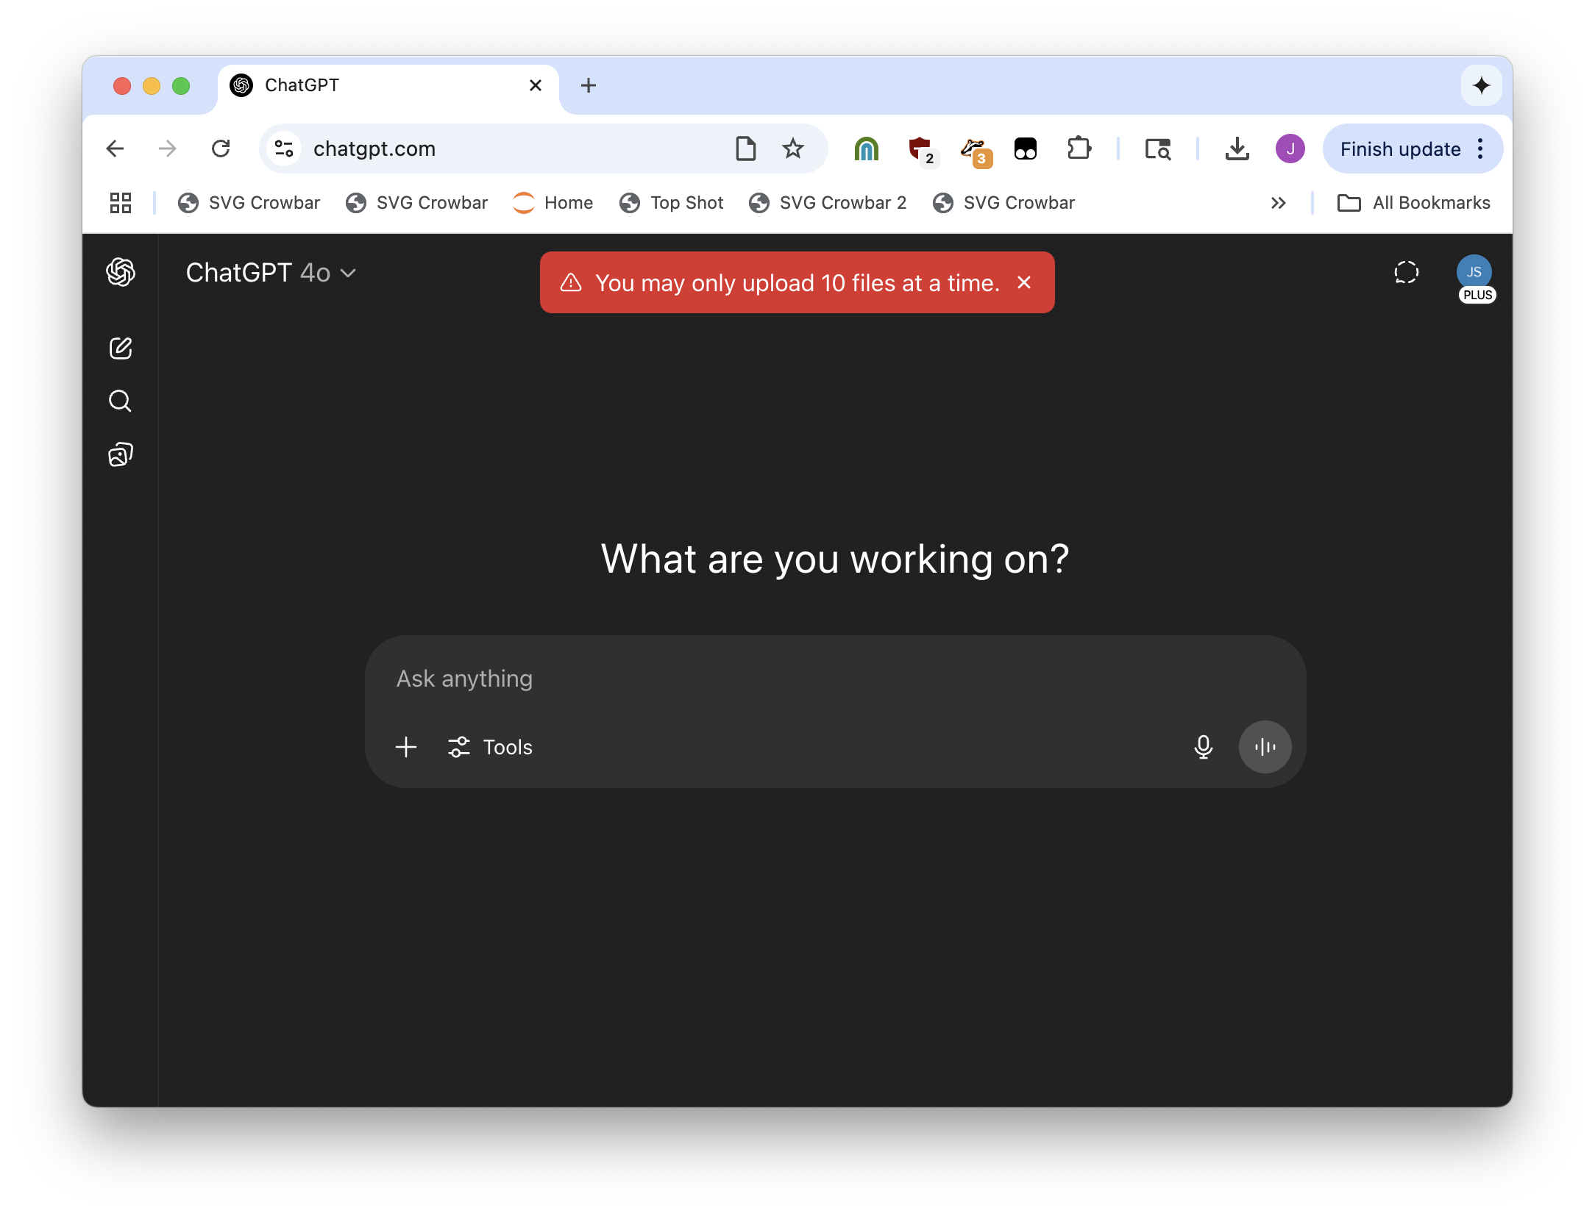
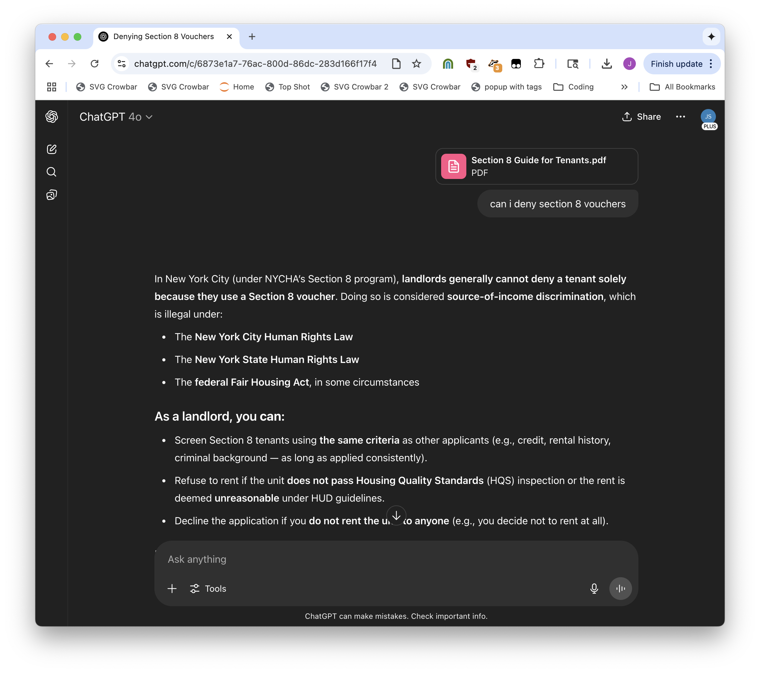

Slide 38
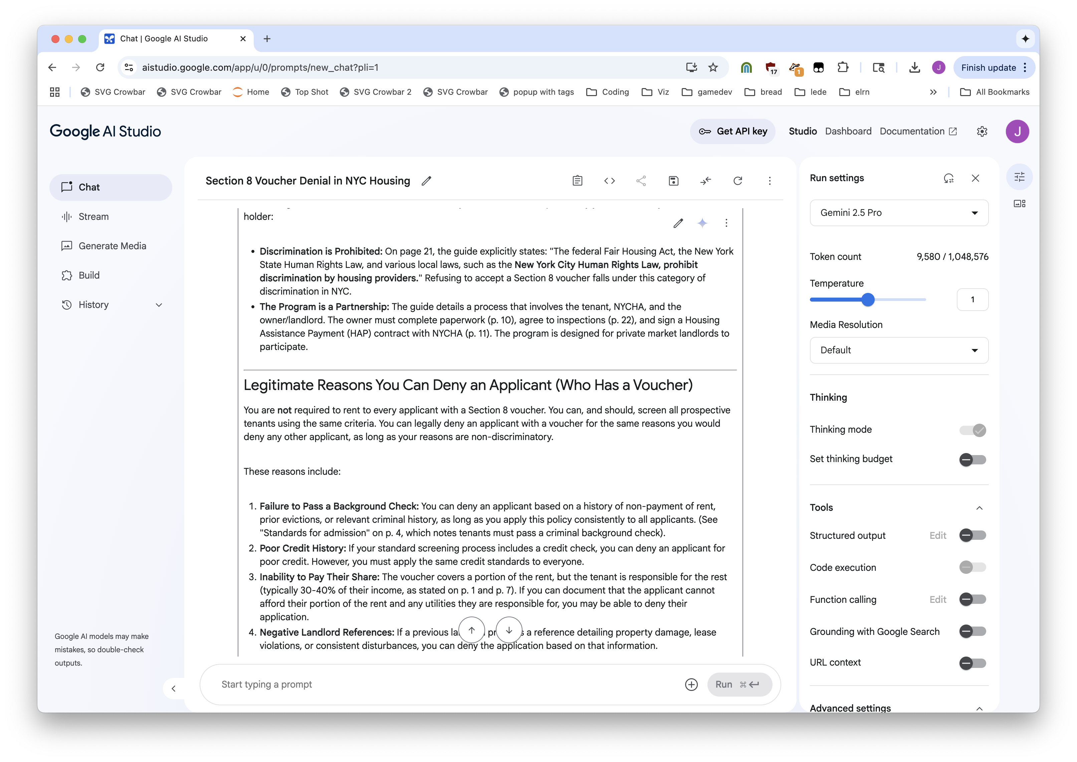


Slide 39
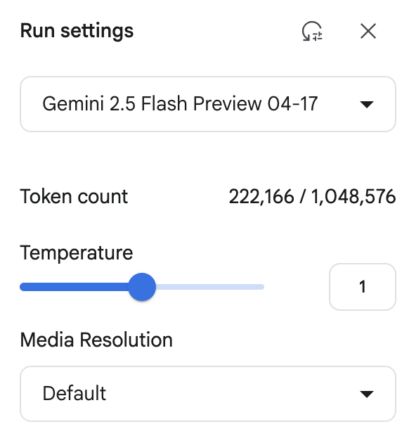
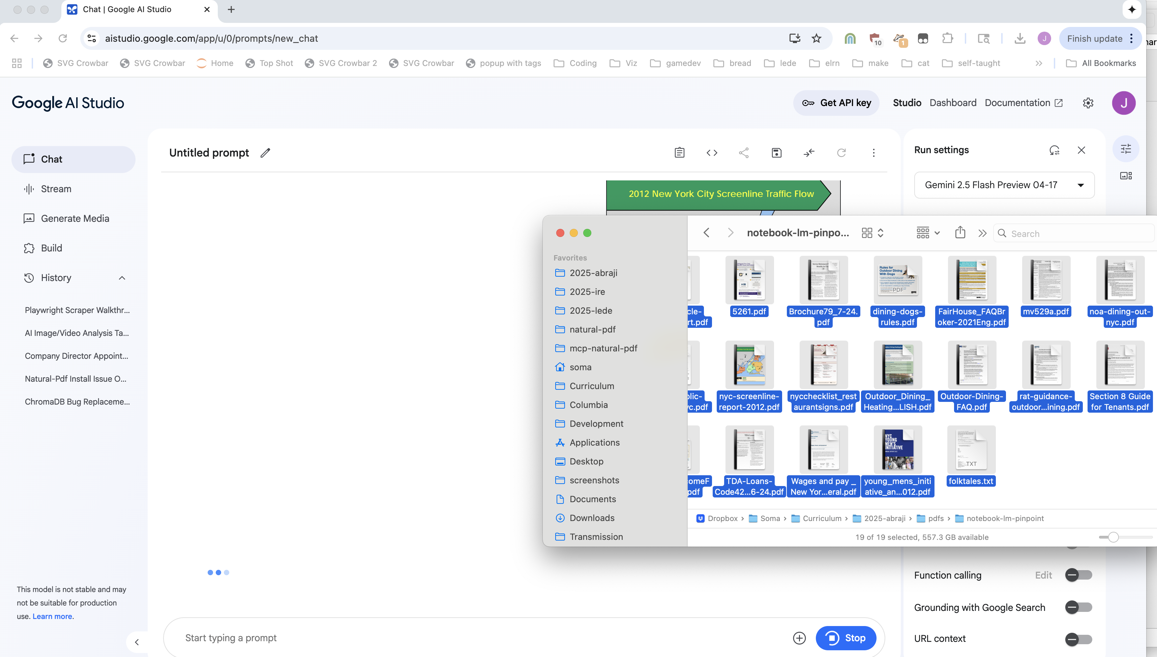


Slide 40
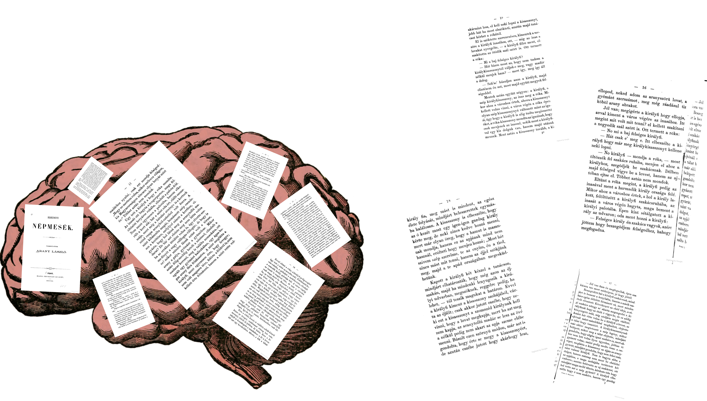

Context window

Slide 41
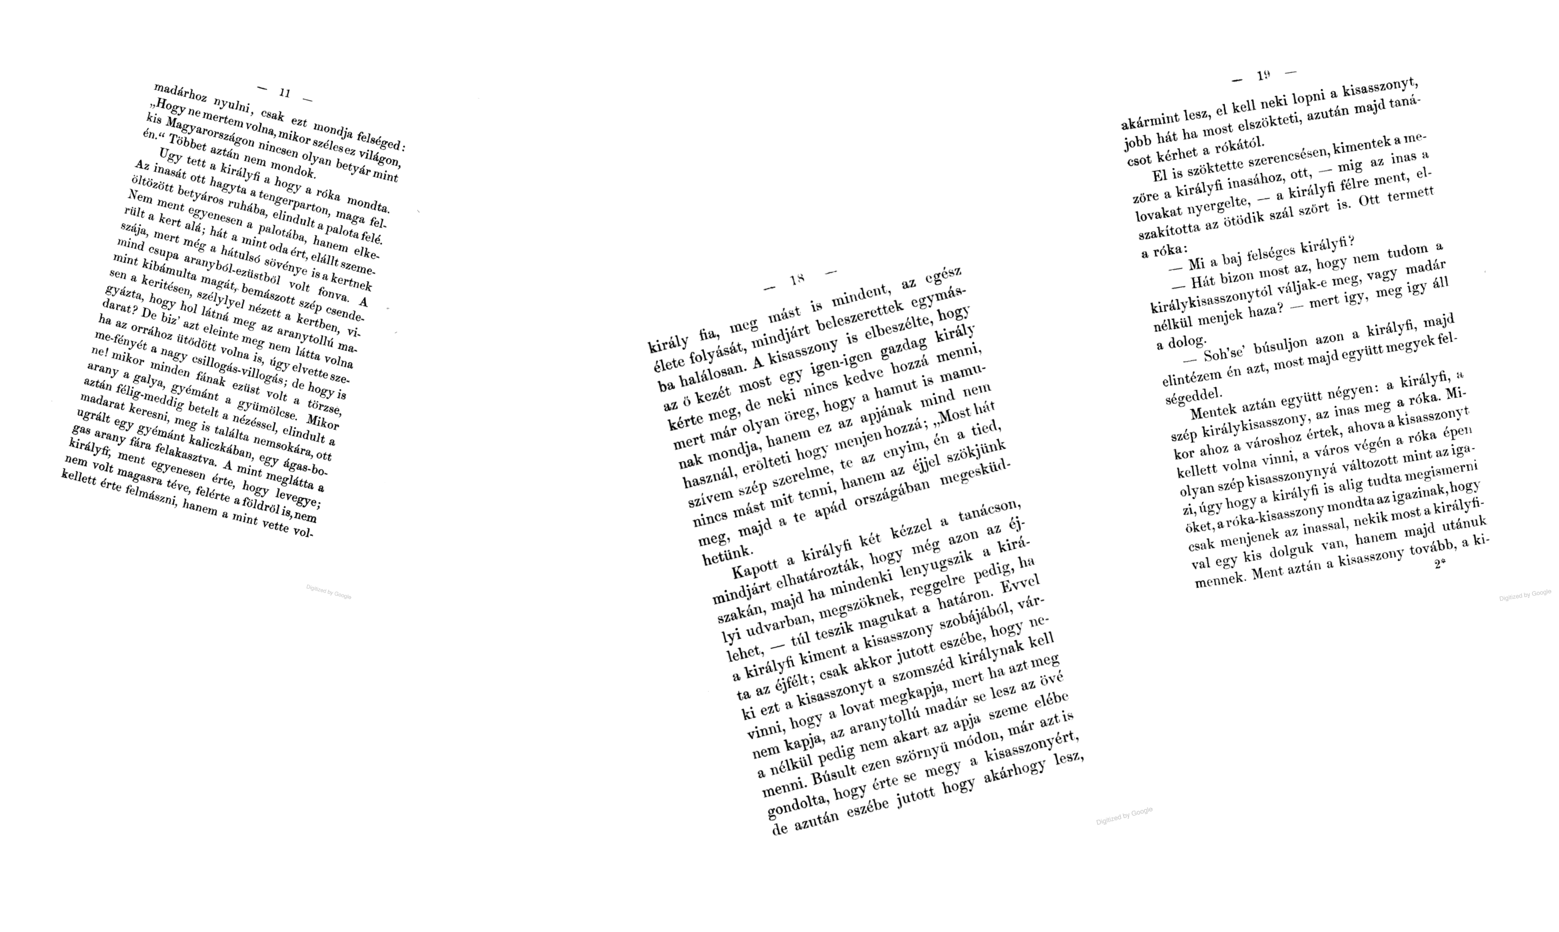



Slice up your document, send top relevant sections with your question

Slide 42
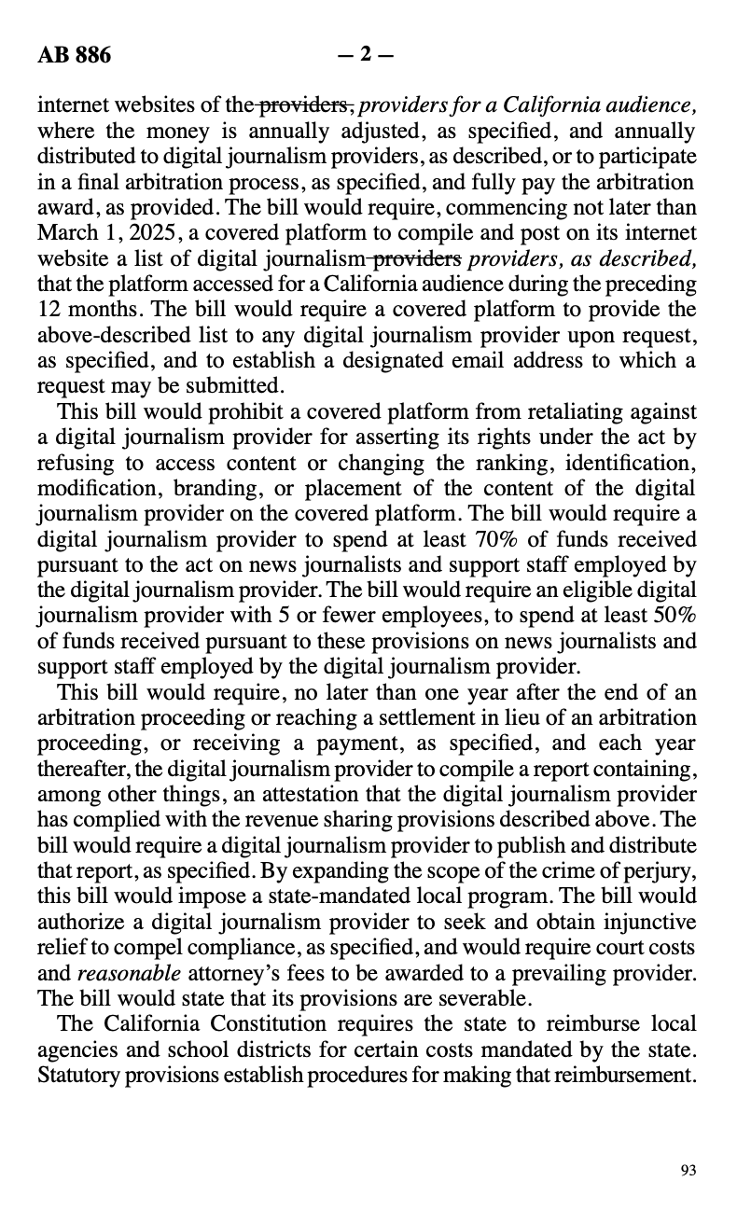







too much content!
what’s relevant?
“answer my question using these 4 sections”
response from AI

Slide 43


Slide 44




Slide 45


Slide 46


Slide 47

But for research: Pinpoint

Slide 48



Slide 49



Slide 50
…but!

Slide 51



Slide 52


Slide 53
The journalism workflow is not the same as the “general bunch of PDFs” workflow

Slide 54

Our PDF workflow is special and specific
Notes:
We value being exactly right
We have very few workflows

Slide 55




Visit https://bit.ly/abraji-pdfs, scroll down down down down down
open all these
Scraping PDFs with Python + Natural PDF
click all these to install

Slide 56


Slide 57


Visit https://bit.ly/abraji-pdfs, scroll down down down down down

Slide 58


Visit https://bit.ly/abraji-pdfs, scroll down down down down down

Slide 59

Visit https://bit.ly/abraji-pdfs, scroll down down down down down

Slide 60

Visit https://bit.ly/abraji-pdfs, scroll down down down down down

Slide 61

Visit https://bit.ly/abraji-pdfs, scroll down down down down down

Slide 62

Visit https://bit.ly/abraji-pdfs, scroll down down down down down

Slide 63
Visit https://bit.ly/abraji-pdfs, scroll down down down down down
open all these
click all these to install

Slide 64
Visit https://bit.ly/abraji-pdfs, scroll down down down down down
Interviewing the worst PDFs on the planet
Jonathan Soma
Knight Chair in Data Journalism
Columbia University
js4571@columbia.edu / @dangerscarf

Slide 65
The more accurate/tabular, the less LLMs are useful (kind of)
But the more general vibes-y the better an LLM is.

Slide 66
=LLM or =CLAUDEEXTRACT if it’s based on the text

Slide 67
Ask an LLM to make your PDF processing workflow engine

Slide 68
But no real text! Images of text! need OCR

Slide 69
One hundred OCR tools one hundred OCR abilities
Tesseract
Acrobat
Other things

Slide 70
You can sometimes trust LLMs, kind of. Everything makes mistakes, just different mistakes.

Slide 71
But especially not with tables. Cascading errors.

Slide 72
AI can be useful but again, lots of different tools not a single workflow… until natural PDF

Slide 73
Control how to find things, like scraping a web page

Slide 74
OCR with many different tools. What is the best? Just try them all.

Slide 75
Find tables through magic, then just loop through all of your PDFs.

Slide 76
Ask questions

Slide 77
Find tables

Slide 78
Find tables + OCR the tables individually

